Slide 1
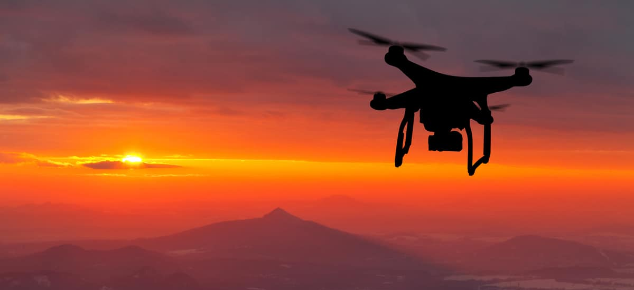

Team 508: Drone Payload Sample Collection
Virtual Design Review 2
Notes:
Size of Apparatus, Energy Usage, Aerodynamic Drag Force, and Weight Distribution

Slide 2
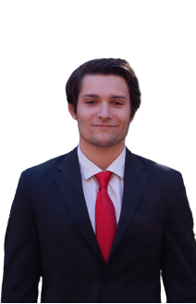
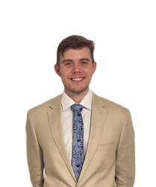
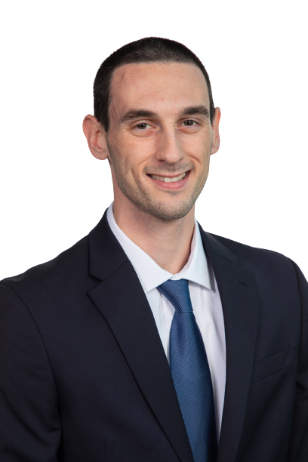
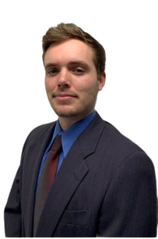
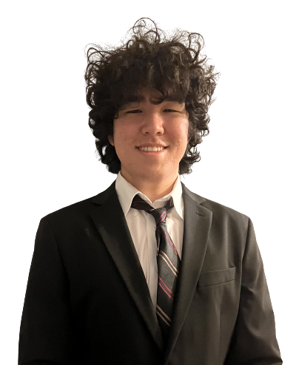
Team Introductions
Dominic Bellocchio
Systems Engineer
Tauben Brenner
Manufacturing
Engineer
Roberto Lacasa
Programming
Engineer
Matthew Lancaster
Control Systems
Engineer
Dylan Ma
Design Engineer
Dylan Ma

Slide 3
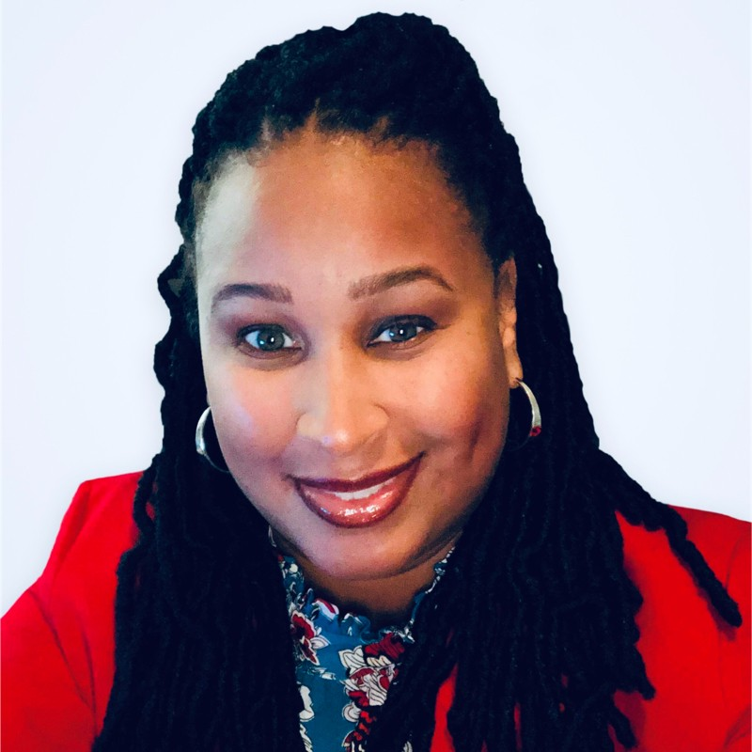
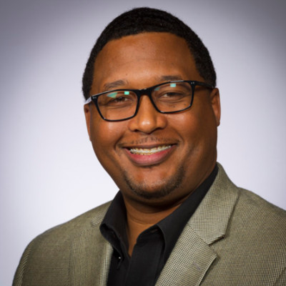
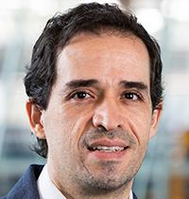
Sponsors and Advisor
Engineering Mentor
Alicia Washington
M&A Senior Project Manager
Dow Chemical
Engineering Mentor
Marcus Rideaux
Global Implementation Leader
Dow Chemical
Academic Advisor
Camilo Ordóñez, Ph.D.
ME Teaching Faculty
Florida State University
Dylan Ma

Slide 4
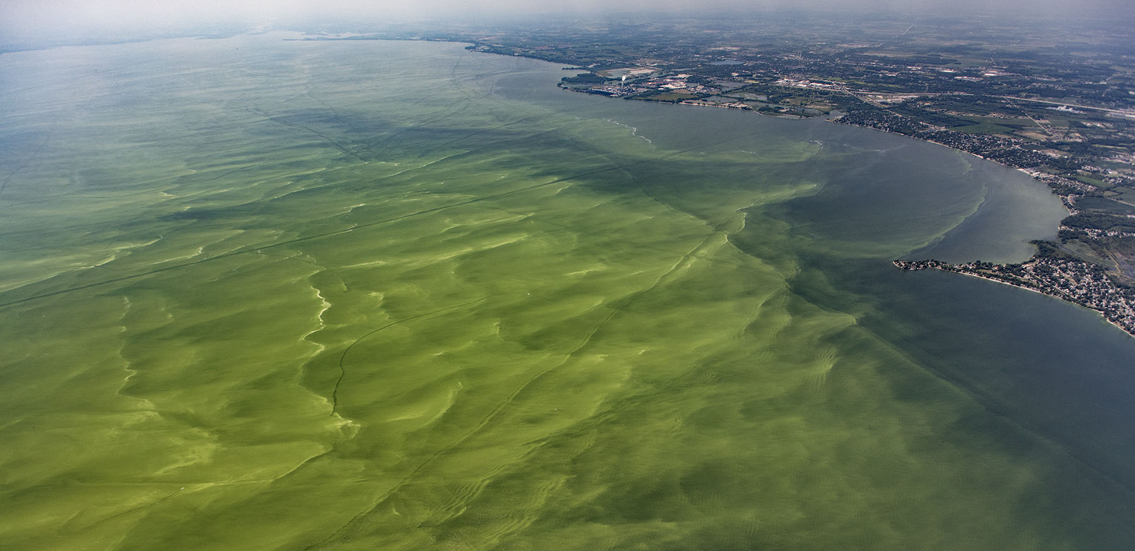
VDR 1 Recap
Dylan Ma

Slide 5

Objective
The objective of this project is to collect liquid samples, prevent contamination, and store the samples safely.
Dylan Ma
Notes:
Give them a reminder of what our project is about.

Slide 6





Customer Needs
Dylan Ma
Notes:
We contacted a marine biologist with questions about collecting ocean samples for harmful substances to the environment.
We have received a response...
Tara specializes in testing for pathogens
Sample size requirements: 100 ml (100 g)
Sample collection requirements: keep it out of sunlight, UV light will harm validity of sample once it is taken (the natural conditions should be altered as little as possible when brought into the lab)
- surface collection is fine, since algae congregate at the surface level in dense portions.
Additional research resources: she told us to check out scholarly research articles related to our sample substances

Slide 7
Customer Needs
Collect & Store Multiple Samples
Dylan Ma
Notes:
We contacted a marine biologist with questions about collecting ocean samples for harmful substances to the environment.
We have received a response...
Tara specializes in testing for pathogens
Sample size requirements: 100 ml (100 g)
Sample collection requirements: keep it out of sunlight, UV light will harm validity of sample once it is taken (the natural conditions should be altered as little as possible when brought into the lab)
- surface collection is fine, since algae congregate at the surface level in dense portions.
Additional research resources: she told us to check out scholarly research articles related to our sample substances

Slide 8
Customer Needs
Compact & Universal
Dylan Ma
Notes:
Compact and universal: Payload must be compact so it is minimally invasive and uses as few materials as possible. Universal because Dow Chemical and Dr. Ordonez use various types of drones for their work on chemical sampling and water sampling respectively.

Slide 9
Customer Needs
Does not Impede Drone
Dylan Ma
Notes:
Does not impede drone. Relates to compactness of payload somewhat, payload should not obstruct drones flight path or draw too much power from the main body.

Slide 10
Customer Needs
Light
&
Balanced
Dylan Ma
Notes:
The payload should be as light as possible, to reduce power consumption, reduce material costs, and minimize effects of weight imbalances on the drone.

Slide 11

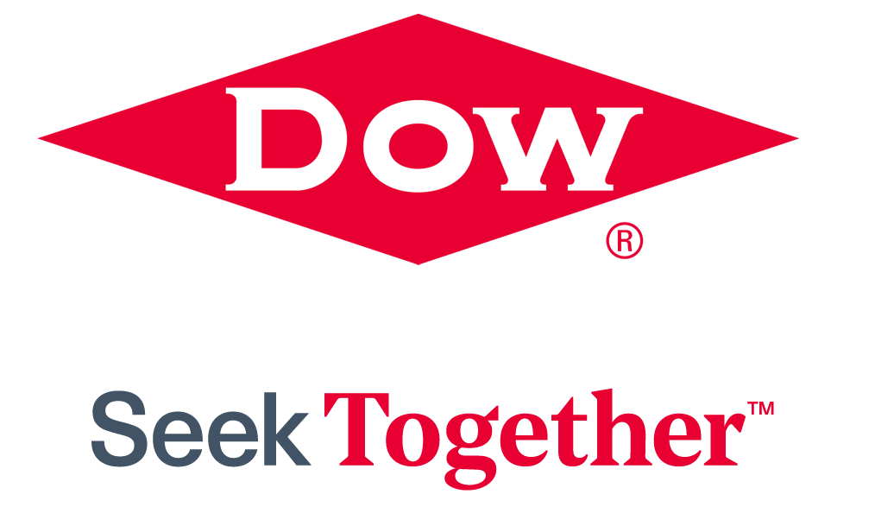
Outside Research
Visual inspections and waste-water sampling
Battery life to weight ratio
Robotics Team
William Rifenburgh and team
Lead Robotics Engineer
Dow Chemical
Hexacopter vs. Quadcopter
Dylan Ma
Notes:
Met with Dow Chemical sponsors about current drone-payload sampling processes and problems with current processes. Discusses about how they use drones to collect and decontaminate sludge samples, or use drones with cameras to inspect vats of chemicals. One of the major issues they told us to think about was the battery life to weight ratio.

Slide 12

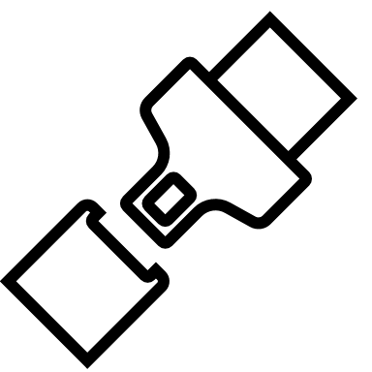



Functional Decomposition
Safety
Stability
Collection
Feedback
Dylan Ma
Notes:
Feedback – communication between the system and the user, it ties back into safety and stability.
The bottom line is that were are taking delicate and sensitive equipment into a chaotic and unpredictable environment, so mitigating disturbances is key.

Slide 13
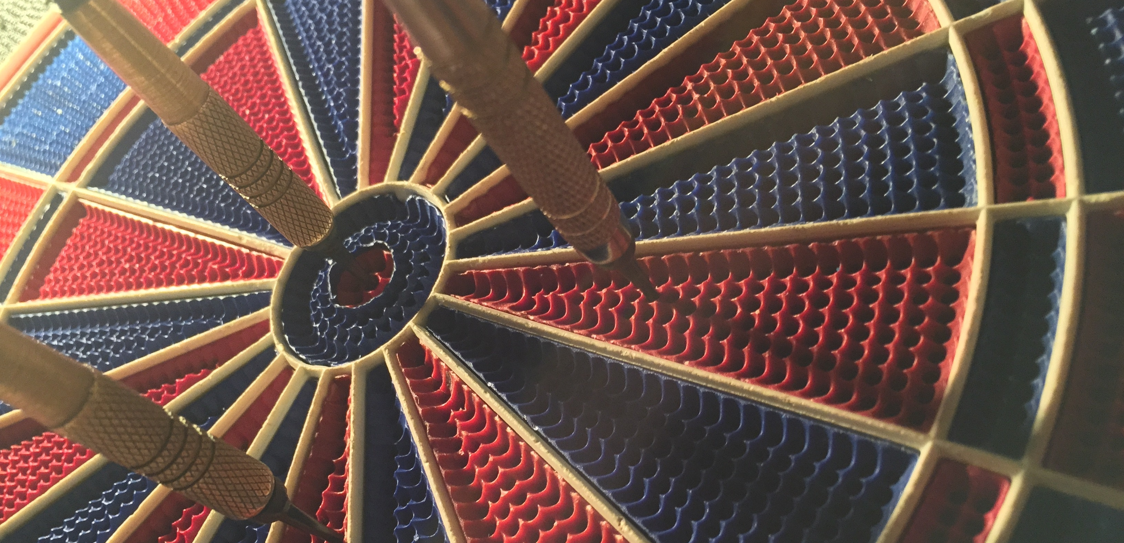
Targets and Metrics
Dylan Ma
Notes:
Using 4 main systems from functional decomposition, safety, stability, collection, and feedback, came up with 17 targets relating to the functions. Our team held an open discussion once these targets were obtained, and each member voted on targets that they believed were most critical to the success of the project. The following slides discuss the 4 critical targets that were chosen.

Slide 14
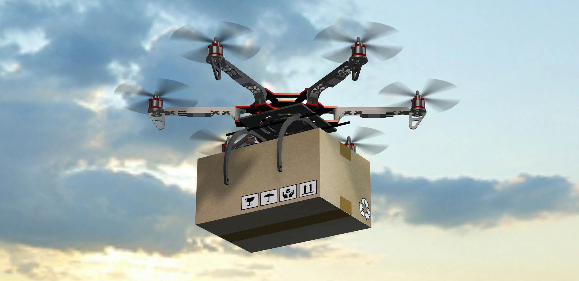
Mounting
Methods
3 Attachments
Dylan Ma
Notes:
Relates to stability function, making sure payload is stable for multiple drone designs.
Critical function is attaches to wide variety of drones. Metric is having various mounting methods to accommodate different bodies. After discussing with Dr. Ordonez and Dow, we decided upon testing the design on at least 3 bodies, due to the fact Dr. Ordonez and Dow use a wide variety of drones for their collection of water and chemical waste samples respectively.
MENTION FAMILY THAT TARGET/METRIC COMES FROM: This one is stability

Slide 15
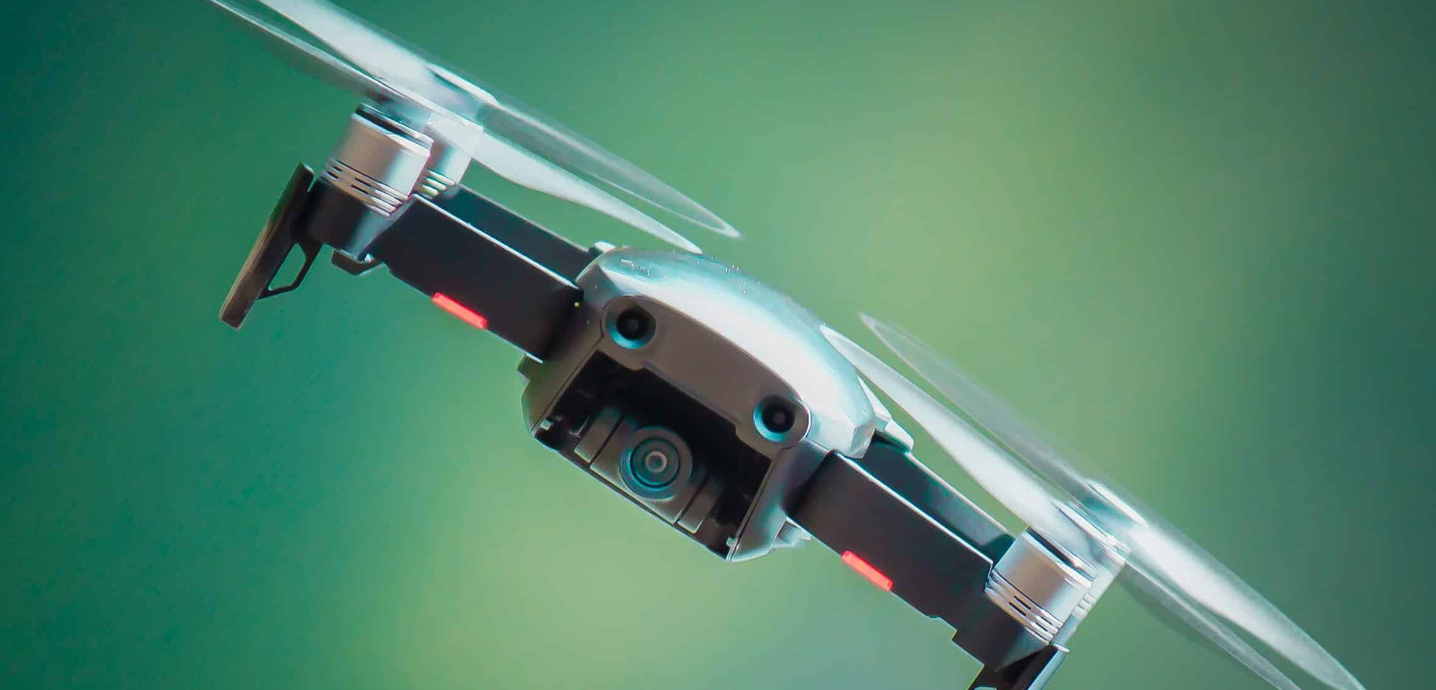
max 100 g offset
Weight
Distribution
Dylan Ma
Notes:
Relates to stability and collection systems. Critical function is maintaining the center of mass of the drone without any tilt along the pitch or roll axes caused by the payload. Thus, we want the payload to have as equal as possible weight distribution. This includes all moving parts, such as motors to control the sampling mechanism, along with the samples themselves. Because the desired mass of one sample is 100 g, the target was chosen as a max of 100g offset for any given amount of samples collected in the payload. This design will be tested once the payload design has been completed, and multiple samples will be placed into the body. A scale will be used to measure the offset on all sides of the payload

Slide 16
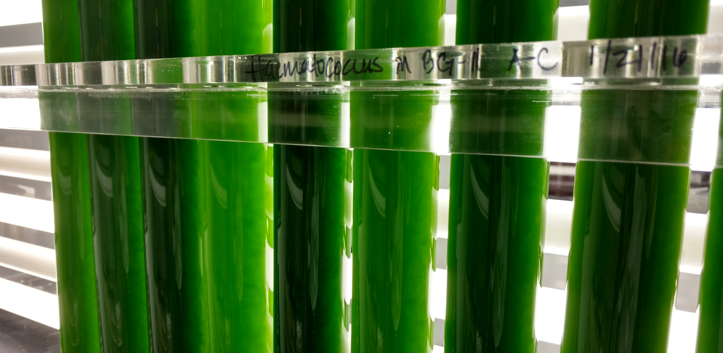
Volume
0 mL
loss
Dylan Ma
Notes:
Deals with safety and collection functions of the design. Once the samples are collected, the payload still has to accomplish its goal of keeping the samples safe for the duration of the flight. As such, our team chose a target and metric of 0 mL volume lost during the entire process. The method of validation is measuring the total amount of the samples collected before being stored in the payload, and measuring the samples volume after a test flight has been run with the samples onboard.

Slide 17
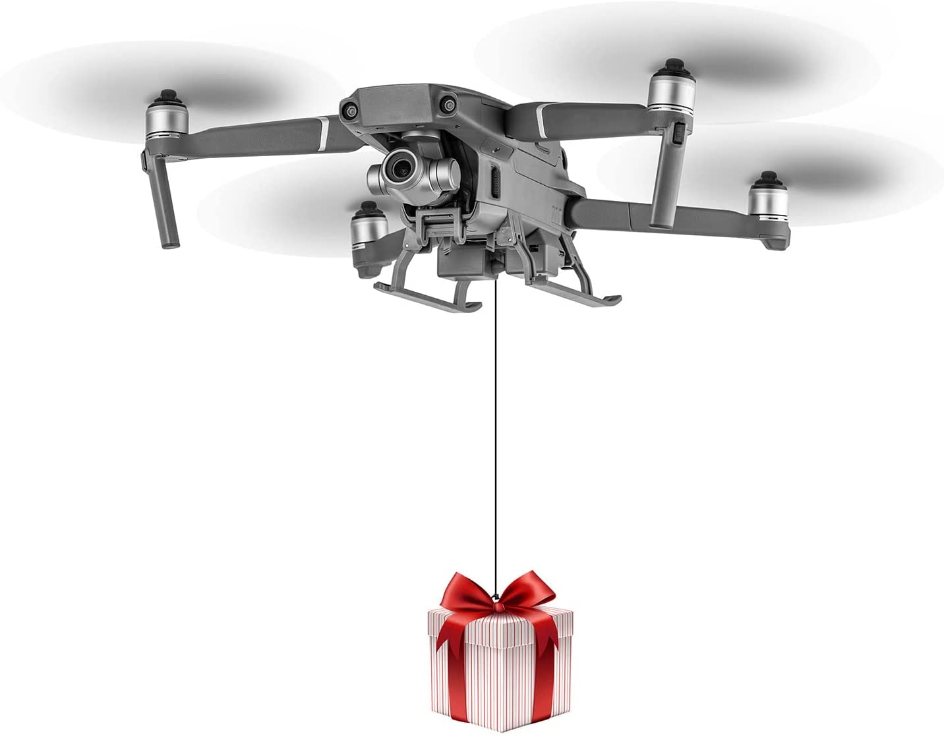
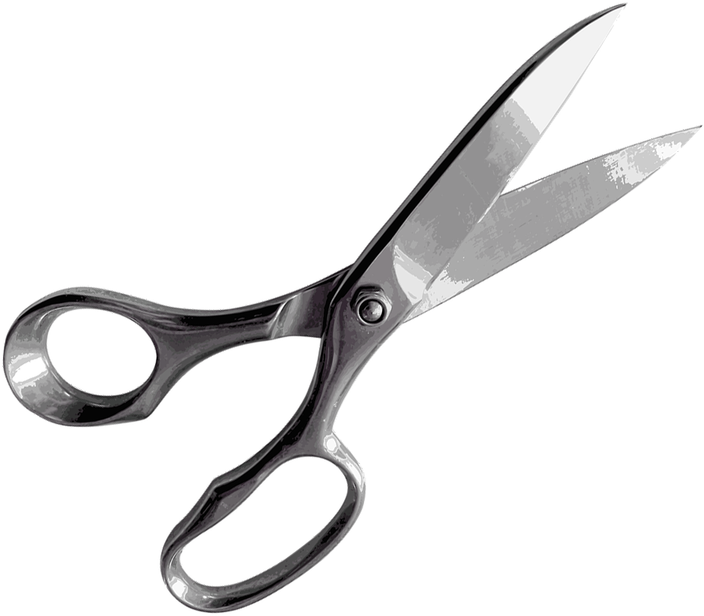
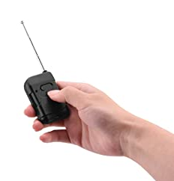
5N tension between payload and sample
Force
Dylan Ma
Notes:
The final critical target involves aborting the sampling procedure of the drone in hazardous situations, which deals with the stability, safety, and feedback systems of the project. Because the approximate force produced by one sample due to gravity is around 1N, the team chose a factor of safety of 5N for each sampling reel to indicate that the reel had been snagged or caught. If this occurred, then the payload would have a built in mechanism to release the sampling reel to protect the rest of the system and minimize losses.

Slide 18
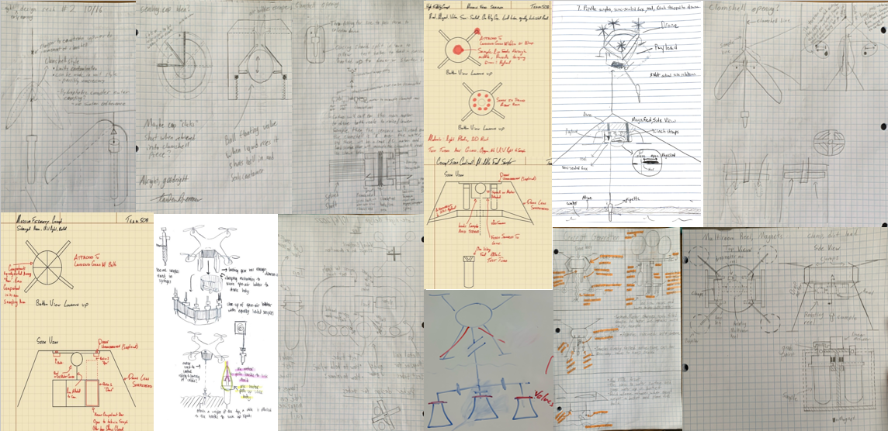
Concept Generation
Matthew Lancaster
Notes:
Transition Slide: discuss how we went from targets and metrics to begin the process of concept generation

Slide 19







Concept Generation
Matthew Lancaster
Notes:
INTRO: Concept generation was divided up into 5 different methods of generating concepts. I will go through the different ways these were helpful.
BRAINSTORMING
Brainstorming was done first and created about 35% of the ideas we listed.
BIOMIMICRY
WHAT WE TRIED:
Biomimicry worked well: We used Frigatebirds idea to provide that we cannot get the drone wet, and it is possible to scoop out of the water
As well we got the idea of using tentacle like arms for scooping
WHAT WE GOT:
Bromeliads were used the shape of their plant bodies to hold water
Using anti problem, we asked ourselves two questions. How to contaminate samples and how to discard samples. Using anti problem, we found possible ways this could happen in our project
We used battle of perspectives to gather different mindsets on how to solve our problem. From this we gained that the sample should be attached simply to the apparatus this would allow
These concept generation methods directly influenced our ideas
ANTIPROBLEM:
WHAT WE TRIED:
How to contaminate, and how to discard the samples?
WHAT WE LEARNED:
Things to watch out for common PITFALLS
Collection storage attachments
Mention animals used, bromeliad
Read concept gen,

Slide 20

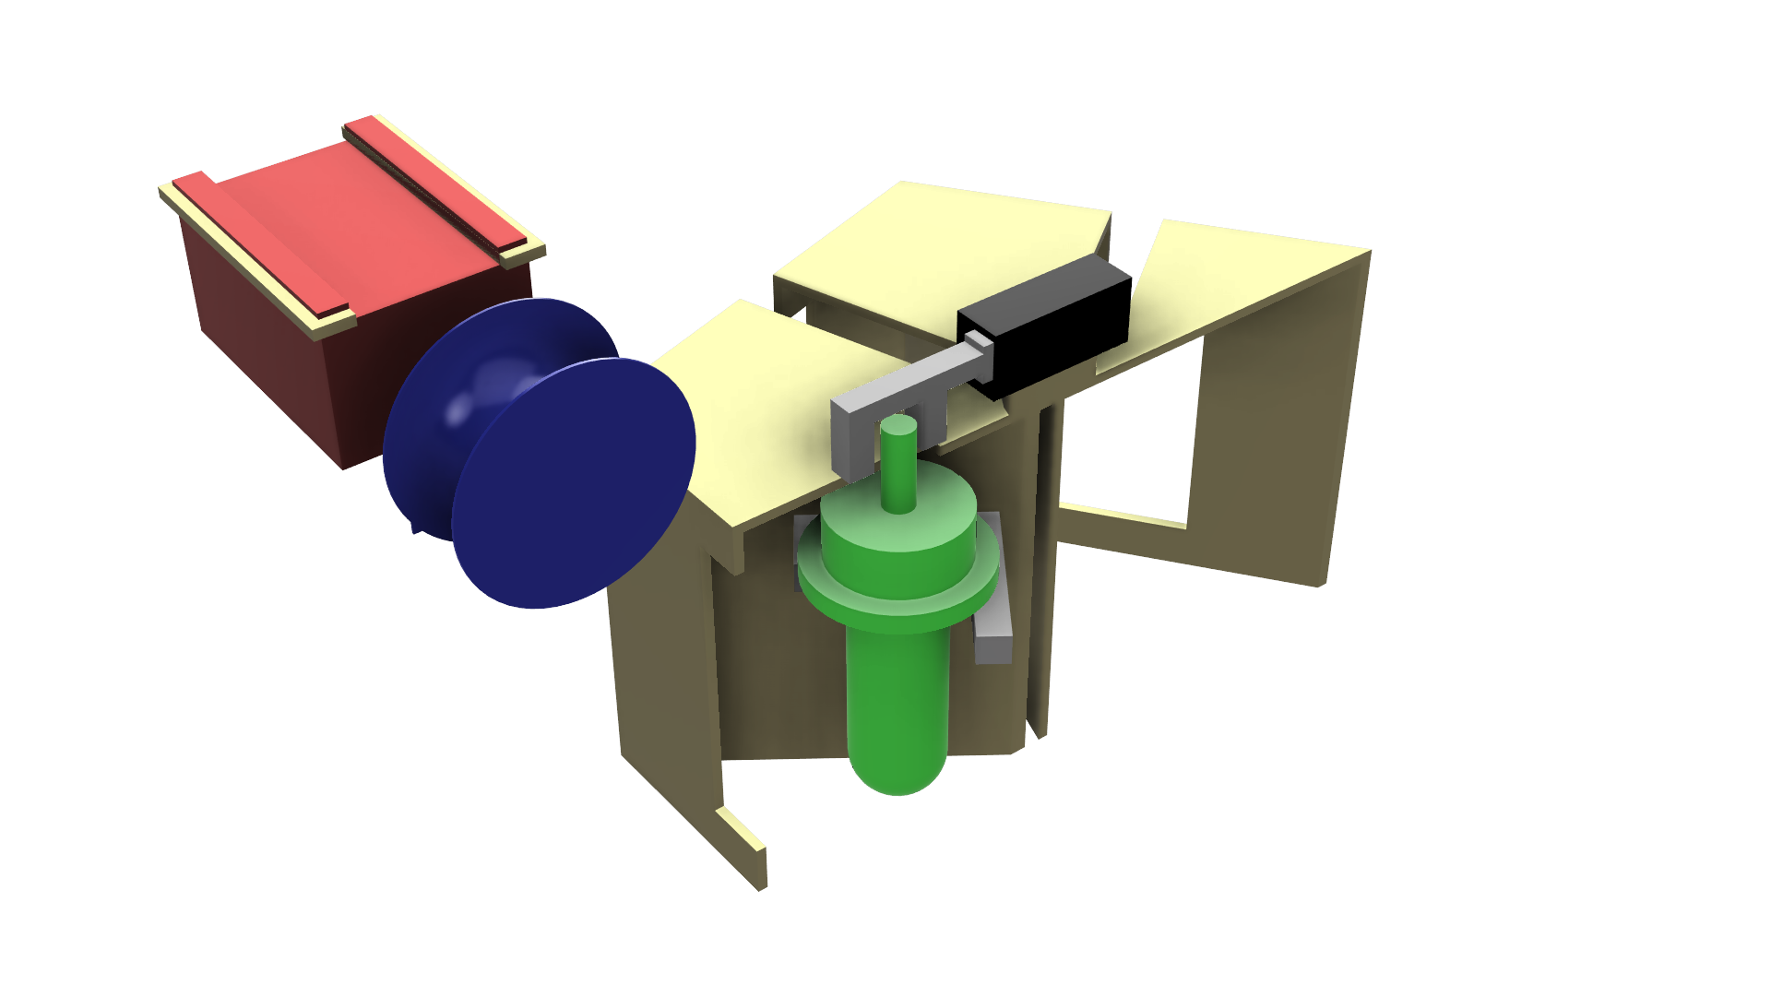
High Fidelity Concept 1
Matthew Lancaster
Notes:
This is the single dynamic reel with rooms
Mention Colors
Whole room is to move
Black and grey is linear actuator that pushes out sample

Slide 21
Matthew Lancaster

Slide 22
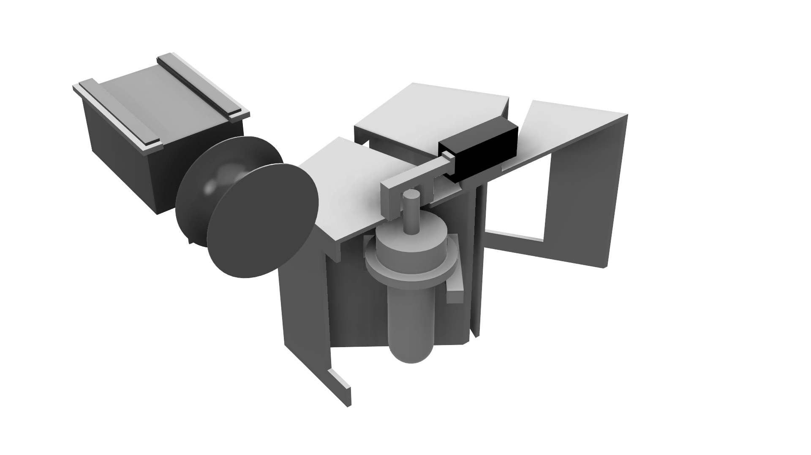
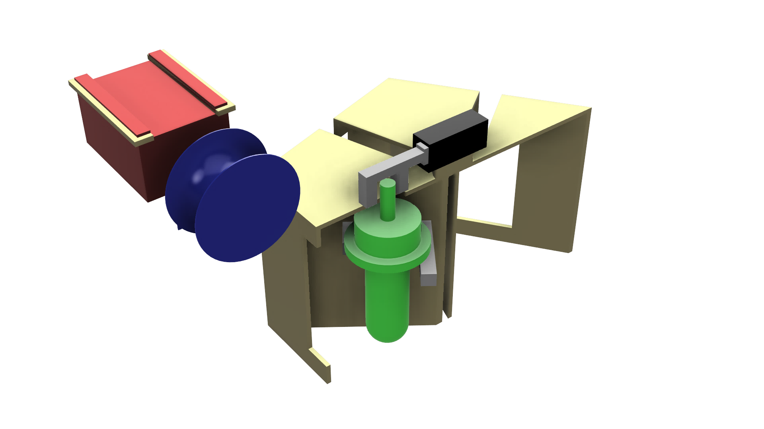
Matthew Lancaster
Notes:
Monofilament fishing line ~4lb test, easy to cut, cheap,

Slide 23
Matthew Lancaster
Notes:
This is a linear actuator that pushes the test tube out of the room through the opening.
The linear actuator would push the test tube to the line attaching and allowing for the sample bottle to drop.
The linear actuator and reel/motor combination stay stationary while the room and samples rotate around the center axis of the actuator
LINEAR ACTUATOR
SPINS THE WHOLE ROOM!!!!! MENTIO THIS

Slide 24
Matthew Lancaster
Notes:
The sample collection bottle features a one way cap that allows for easy water intake once deposited in the water.

Slide 25
Matthew Lancaster
Notes:
The room feature would allow for protection from sunlight as well as from other samples in the event any of the samples were to break.
This was considered as a high-fidelity target based off its satisfaction of balance, storing samples safely, and

Slide 26
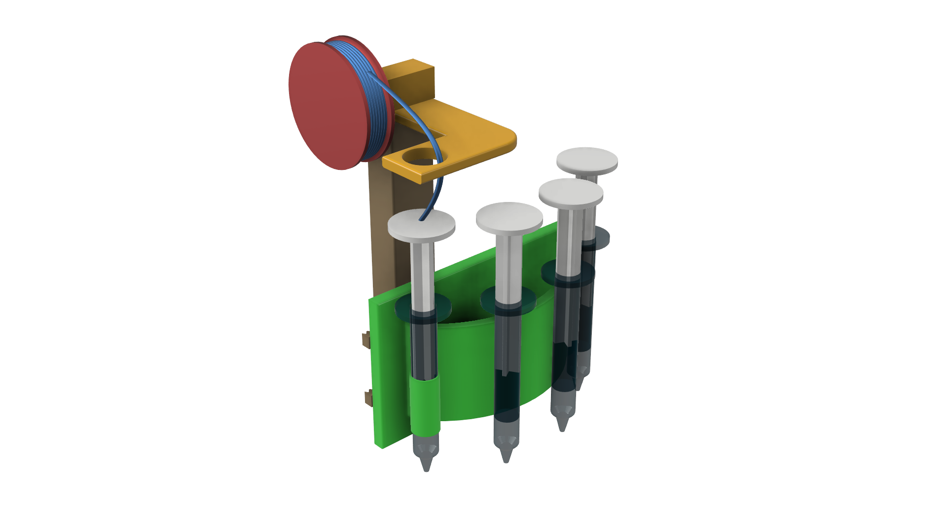
High Fidelity Concept 2
Matthew Lancaster
Notes:
This is our high-fidelity concept 2.
Syringe collection design with open air storage

Slide 27
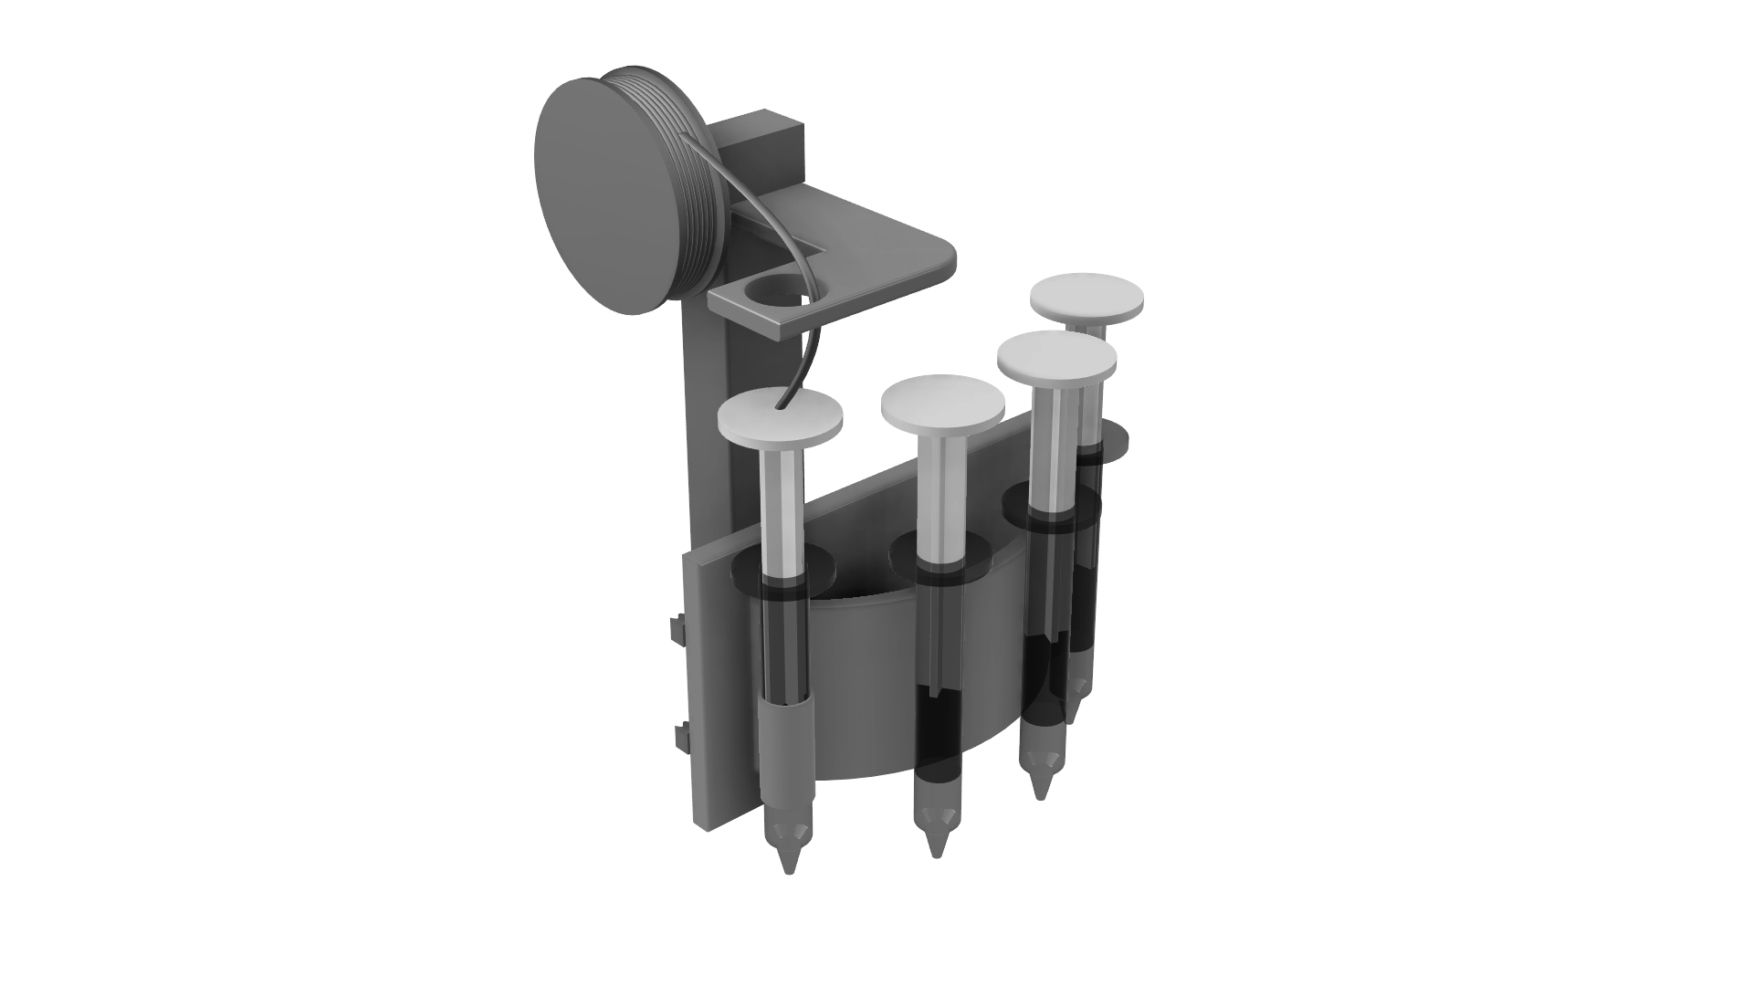
Matthew Lancaster
Notes:
Line with

Slide 28
Matthew Lancaster
Notes:
Talk about the syringe and using the apparatus

Slide 29
Matthew Lancaster
Notes:
Talk about the line up of syringes for samples

Slide 30
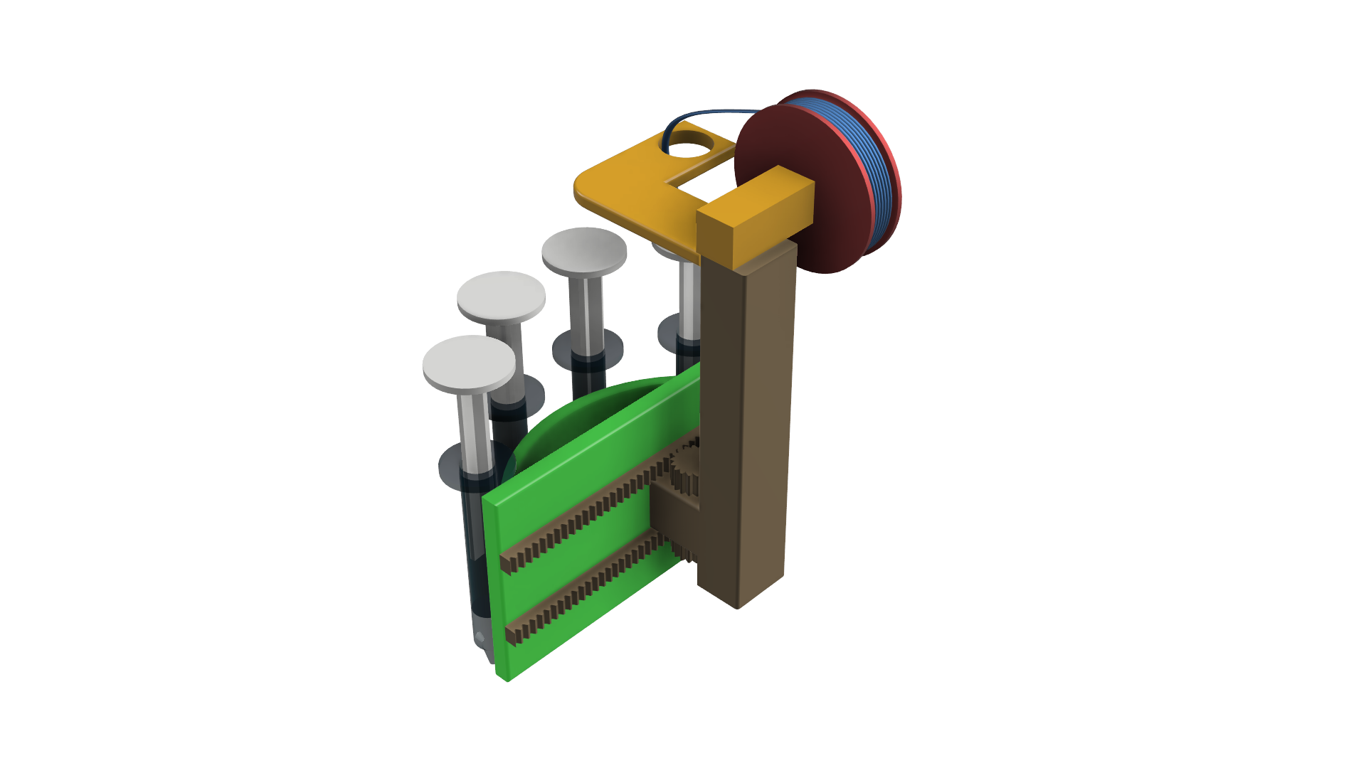
Matthew Lancaster
Notes:
Transition slide

Slide 31
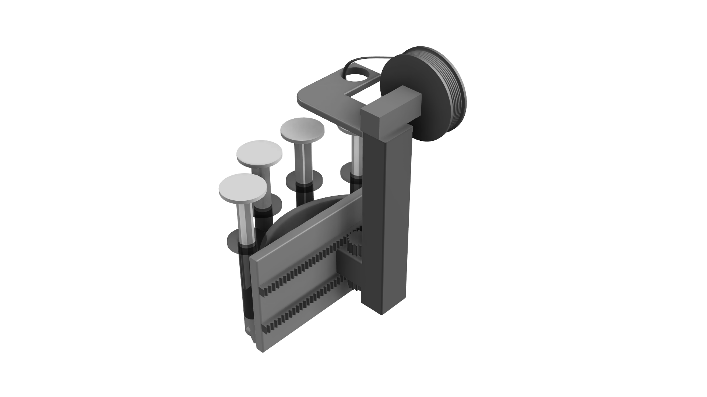
Matthew Lancaster

Slide 32
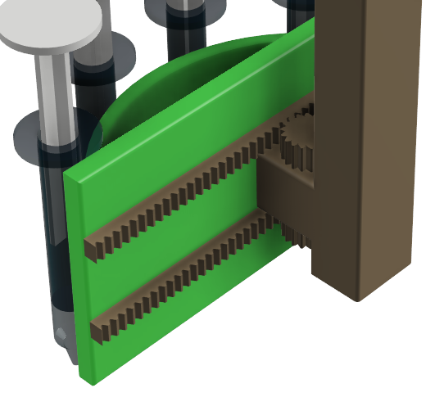
Matthew Lancaster
Notes:
Talk about the linear rail for moving from sample to sample

Slide 33
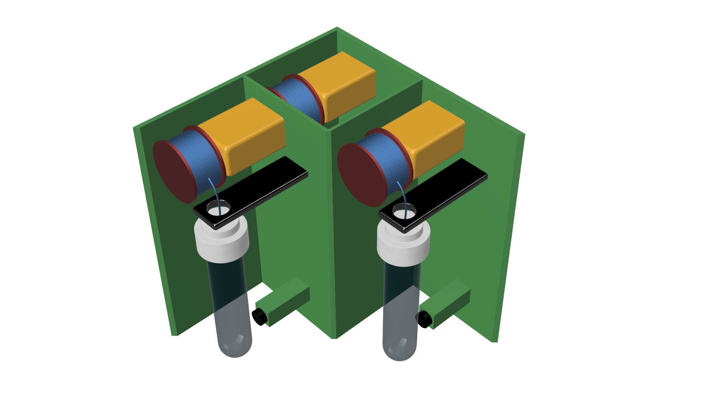
High Fidelity Concept 3
Matthew Lancaster
Notes:
Coupled motor sample concept

Slide 34
Matthew Lancaster
Notes:
Transition slide

Slide 35
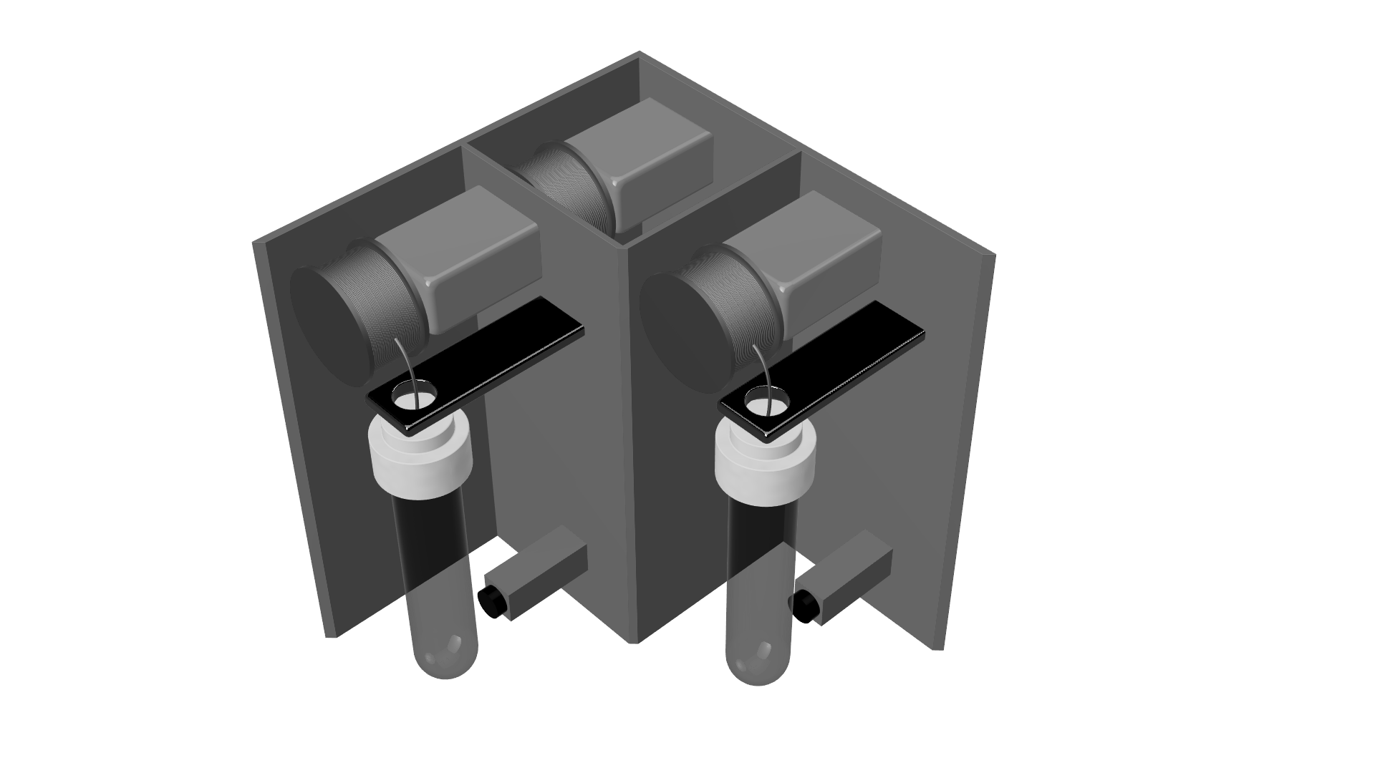
Matthew Lancaster
Notes:
Talk about how each sample will have its own individual motor

Slide 36
Matthew Lancaster
Notes:
Discuss the motor reel assembly idea and one way test tube

Slide 37
Matthew Lancaster
Notes:
Discuss how the magnet will hold the sample stationary.

Slide 38
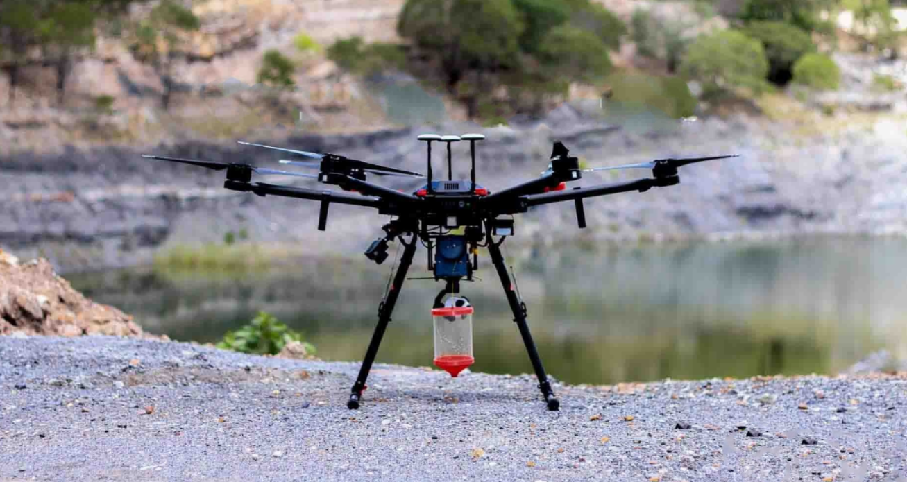
Market Option
Matthew Lancaster
Notes:
The market options seen here exhibits similar design…
But it only takes one sample.
It doesn’t store or protect, it

Slide 39
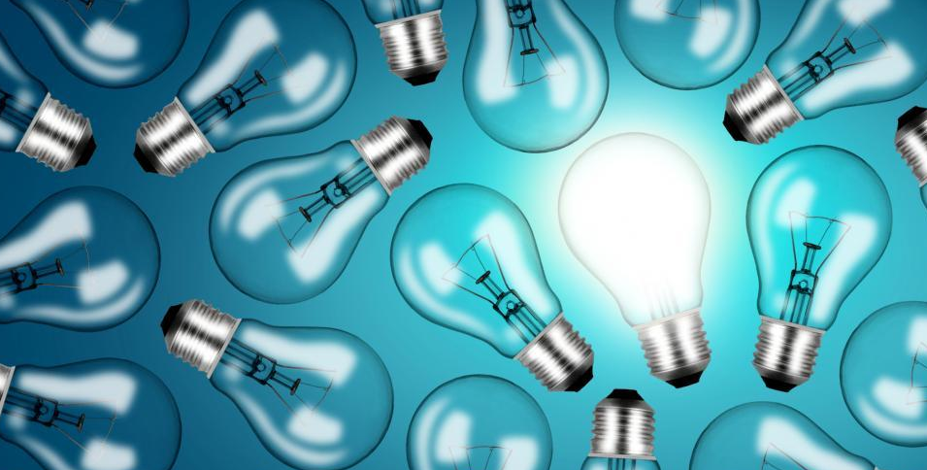
Concept
Selection
Tauben Brenner

Slide 40





Concept Selection
Binary Pairwise
House of Quality
Pugh Chart
Analytical Hierarchy
Tauben Brenner
Notes:
BPwC: Ranked our 9 customer requirements in an order using rating for 0 or 1 to gauged importance vs eachother. This gave us relative weights to use in the HoQ
HoQ: Measured how well each requirement related to the 11 engineering characteristics we generated
PC: in the first iteration, compared the medium and high fidelity concepts against a market option found online.

Slide 41
Concept Selection
Binary Pairwise
Customer Needs
Customer Requirements
Tauben Brenner
Notes:
BPwC: Ranked our 9 customer requirements in an order using rating for 0 or 1 to gauged importance vs eachother. This gave us relative weights to use in the HoQ
FIND SPECIFIC THINGS TO MENTION
Multiple Samples, Store Samples, Collect samples, does not critically impede flight

Slide 42
Concept Selection
House of Quality
Targets and Metrics
Engineering Characteristics
Customer Requirements
Tauben Brenner
Notes:
HoQ: Measured how well each requirement related to the 11 engineering characteristics we generated . Used the importance weight factors of each customer requirement to determine a ranked order of which engineering characteristics were most important to use in the Pugh Charts. The top 5 of the 11 engineering characteristics were used
FIND SPECIFIC THINGS TO MENTION
Most important: Overall weight
Size of apparatus, energy usage, aerodynamic drag force, weight distribution

Slide 43
Concept Selection
Pugh Chart
Concepts
Final Evaluation Concepts
Engineering Characteristics
Tauben Brenner
Notes:
PC: in the first iteration, compared the medium and high fidelity concepts against a market option found online.
FIND SPECIFIC THINGS TO MENTION
WHAT WERE THE THINGS COMPARED
Compared them to a datum which was water pump w one sample
Mention slimming from 8 concepts to 5 and then further passed 3 to AHP

Slide 44

Concept Selection
Analytical Hierarchy
Final Evaluation Concepts
Final Concept
Engineering Characteristics
Tauben Brenner
Notes:
Compared three final evaluation concepts against each other, comparing how each best fulfills the individual engineering characteristic
FIND SPECIFIC THINGS TO MENTION

Slide 45


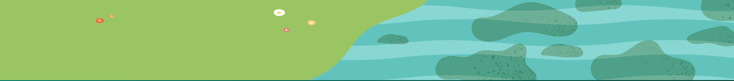
Final Concept
Tauben Brenner
Notes:
So last time we spoke we showed this animation to

Slide 46
Tauben Brenner
Notes:
So last time we spoke we showed this animation to

Slide 47
Tauben Brenner
Notes:
So last time we spoke we showed this animation to

Slide 48
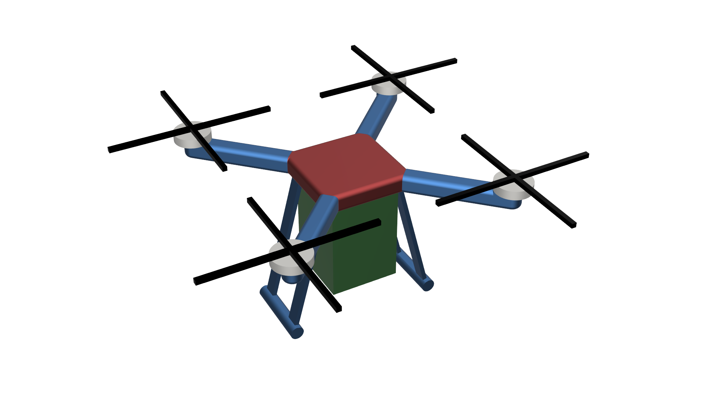
Tauben Brenner
Notes:
Winning design in the green box of the drone, shown exactly how it would be mounted on a typical drone.

Slide 49
Tauben Brenner
Notes:
So last time we spoke we showed this animation to

Slide 50
Tauben Brenner
Notes:
Overall weight, Size of Apparatus, Energy Usage, Aerodynamic Drag Force, and Weight Distribution were the main engineering characteristics
Overall weight is low because fewer complicated linkages and no high-force stress points to reinforce
Aerodynamic bc entire box sealed and can be altered to have good aero properties
Low energy usage because motor can be geared to be in most energy efficient region
Size of apparatus beneficial because it is simple and can have each item reduced in size
Weight distribution will be manually controlled by collecting bottles at opposing weight points

Slide 51



Future Work
Bill of Materials
Prototyping
Tauben Brenner
Notes:
Note that also need to create a spring project plan before the semester is over.
In terms of prototyping: Toyota's motto is: "tape it, glue it, weld it" this is how we are going to approach prototyping.
We also will create and present a poster of the project's updates

Slide 52
Backup Slides

Slide 53

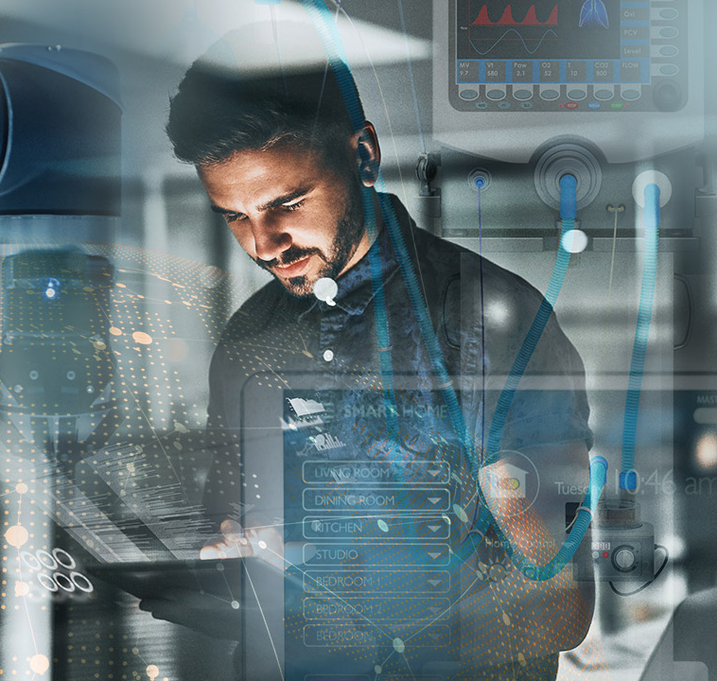
Critical Needs
and Characteristics
Tauben Brenner
Notes:
Talk about the 5 most important engineering characteristics. Mention 1) does not critically impede flight, 2) collect samples, 3) store samples, 4) multiple samples were the 4 critical customer requirements

Slide 54
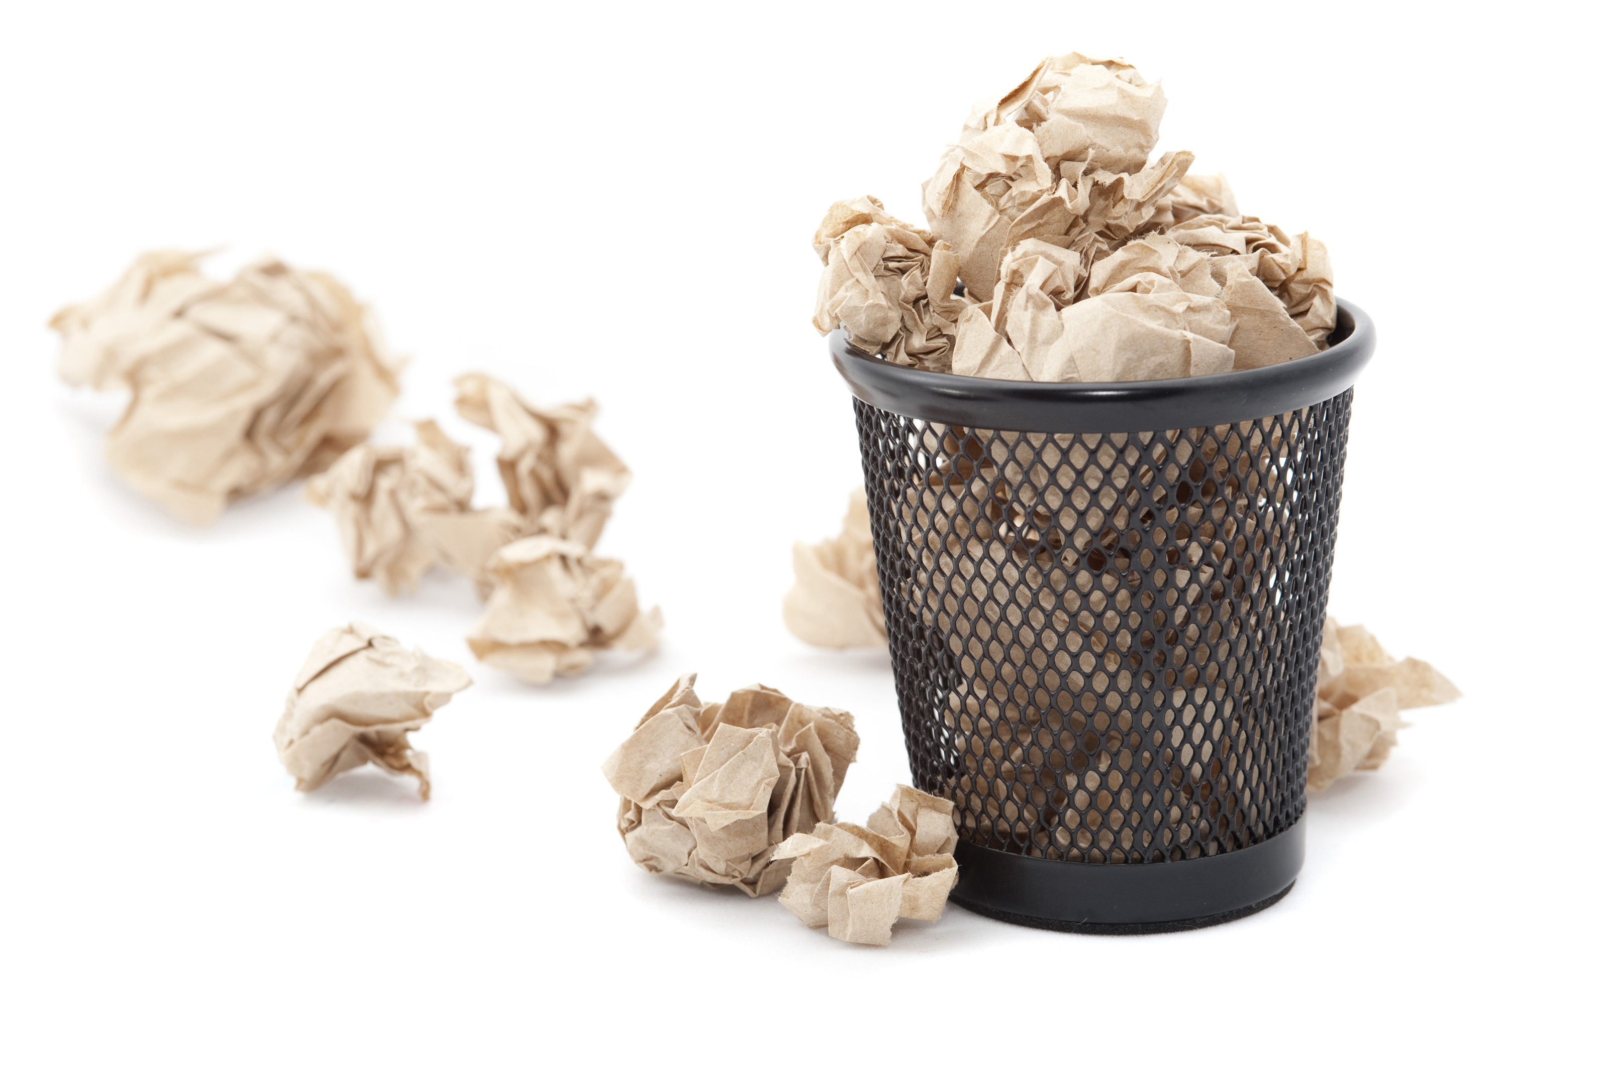
Discarding Concepts
Tauben Brenner
Notes:
Talk about how the concepts from the concept generation stage were compared among the customer needs and engineering characteristics and then further narrowed down from there.

Slide 55
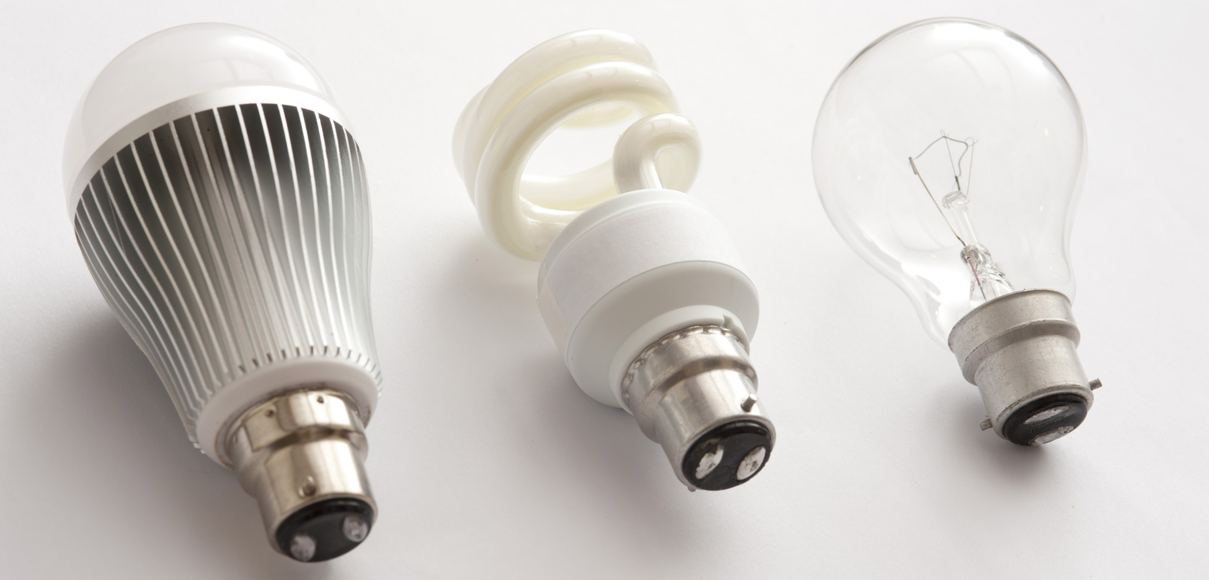
Final Three
Tauben Brenner
Notes:
From the pugh chart we get the final 3 concepts, multiroom reel, syringe collection, separate reels one way cap,
Then compared the engineering characteristics between each other to find their individual relative weight, and further compared each concept to each other based on the most important engineering characteristics.
MultiReel one way cap had 0.51 out of 1 for the final weighting, showing that it is the ideal design

Slide 56
Customer Needs
Collect & Store Multiple Samples
Dylan Ma
Notes:
We contacted a marine biologist with questions about collecting ocean samples for harmful substances to the environment.
We have received a response...
Tara specializes in testing for pathogens
Sample size requirements: 100 ml (100 g)
Sample collection requirements: keep it out of sunlight, UV light will harm validity of sample once it is taken (the natural conditions should be altered as little as possible when brought into the lab)
- surface collection is fine, since algae congregate at the surface level in dense portions.
Additional research resources: she told us to check out scholarly research articles related to our sample substances

Slide 57
Customer Needs
Compact & Universal
Dylan Ma
Notes:
We contacted a marine biologist with questions about collecting ocean samples for harmful substances to the environment.
We have received a response...
Tara specializes in testing for pathogens
Sample size requirements: 100 ml (100 g)
Sample collection requirements: keep it out of sunlight, UV light will harm validity of sample once it is taken (the natural conditions should be altered as little as possible when brought into the lab)
- surface collection is fine, since algae congregate at the surface level in dense portions.
Additional research resources: she told us to check out scholarly research articles related to our sample substances

Slide 58
Customer Needs
Does not Impede Drone
Dylan Ma
Notes:
We contacted a marine biologist with questions about collecting ocean samples for harmful substances to the environment.
We have received a response...
Tara specializes in testing for pathogens
Sample size requirements: 100 ml (100 g)
Sample collection requirements: keep it out of sunlight, UV light will harm validity of sample once it is taken (the natural conditions should be altered as little as possible when brought into the lab)
- surface collection is fine, since algae congregate at the surface level in dense portions.
Additional research resources: she told us to check out scholarly research articles related to our sample substances

Slide 59
Customer Needs
Light
&
Balanced
Dylan Ma
Notes:
We contacted a marine biologist with questions about collecting ocean samples for harmful substances to the environment.
We have received a response...
Tara specializes in testing for pathogens
Sample size requirements: 100 ml (100 g)
Sample collection requirements: keep it out of sunlight, UV light will harm validity of sample once it is taken (the natural conditions should be altered as little as possible when brought into the lab)
- surface collection is fine, since algae congregate at the surface level in dense portions.
Additional research resources: she told us to check out scholarly research articles related to our sample substances

Slide 60
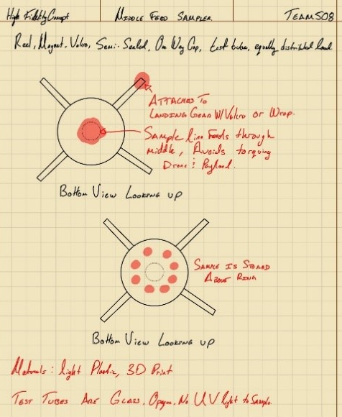
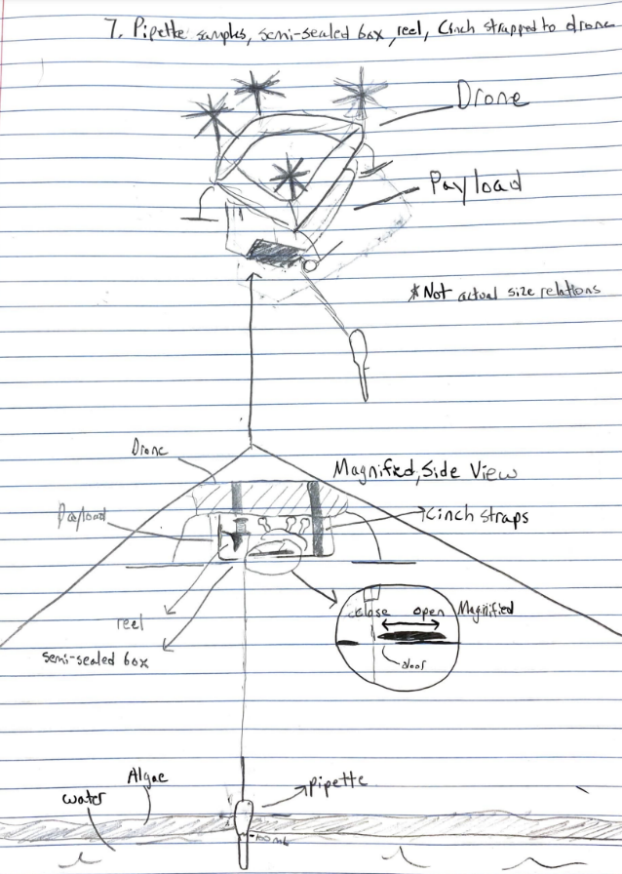
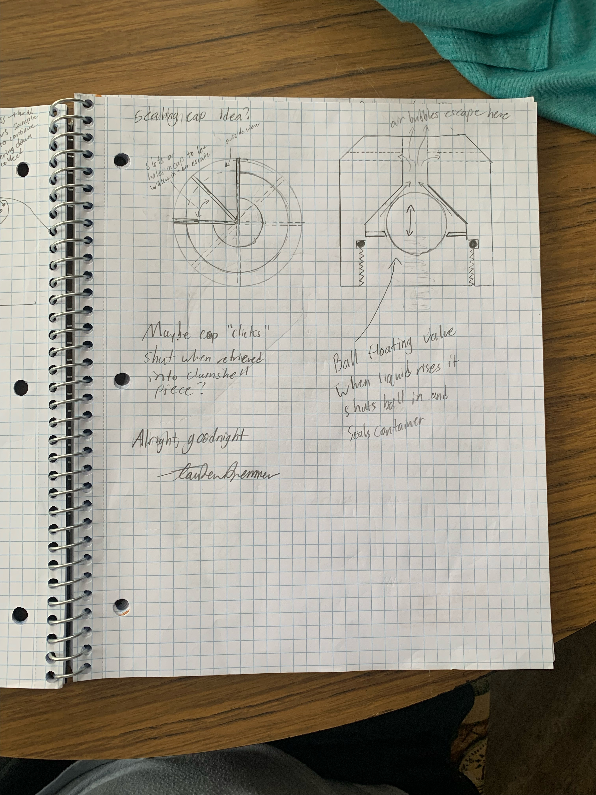
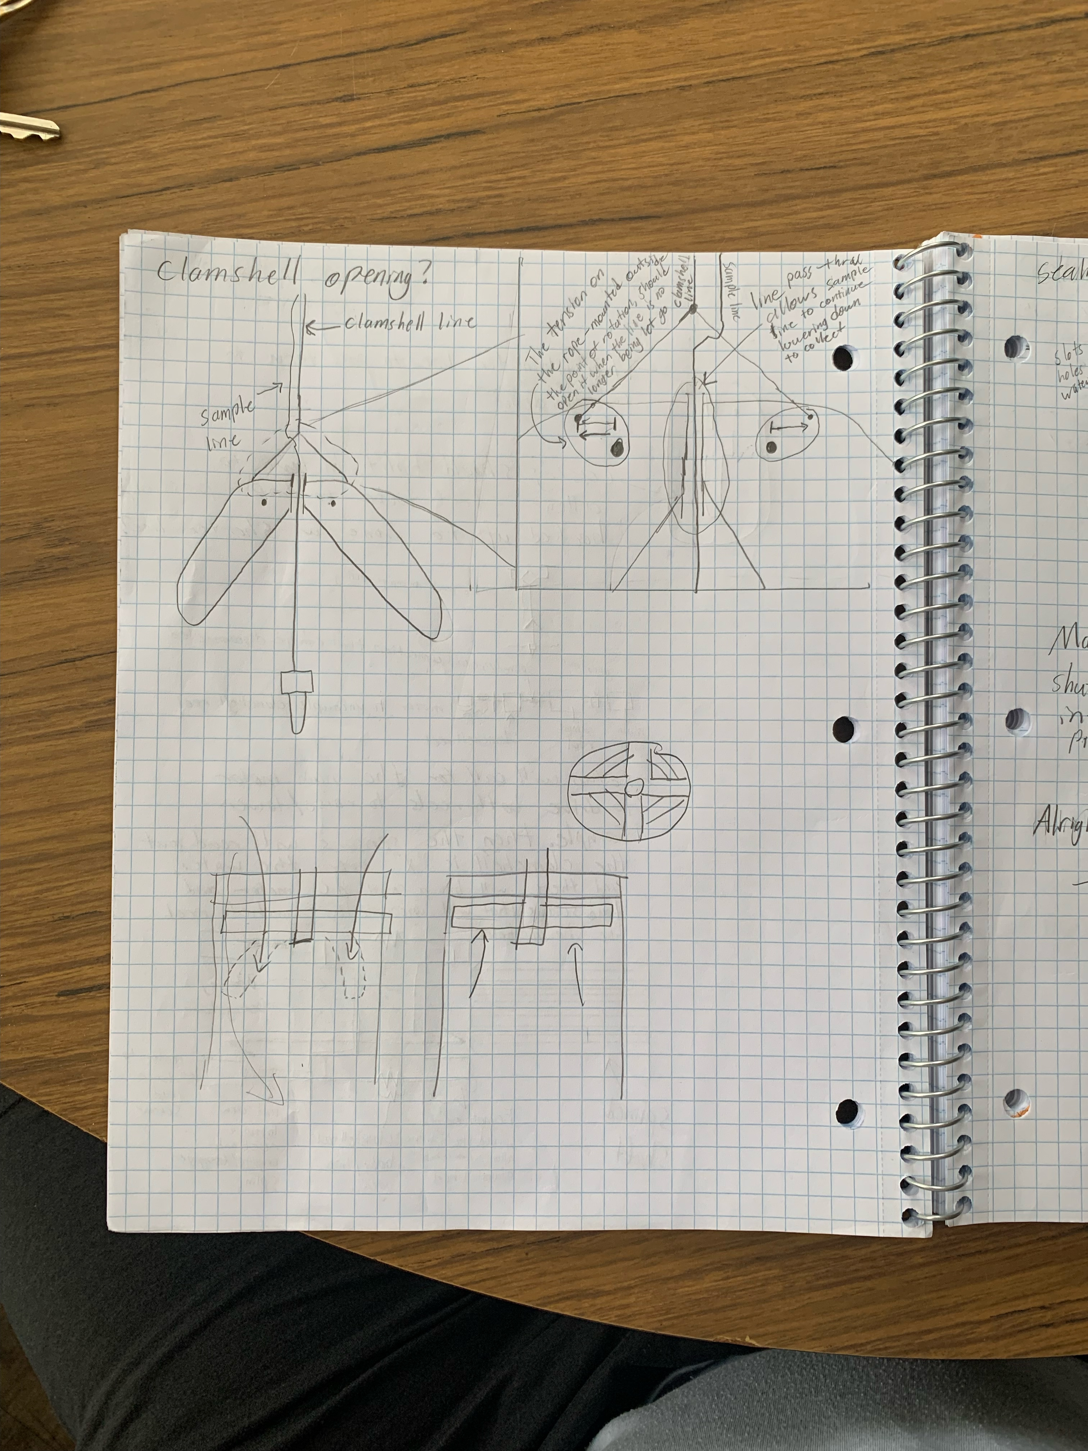
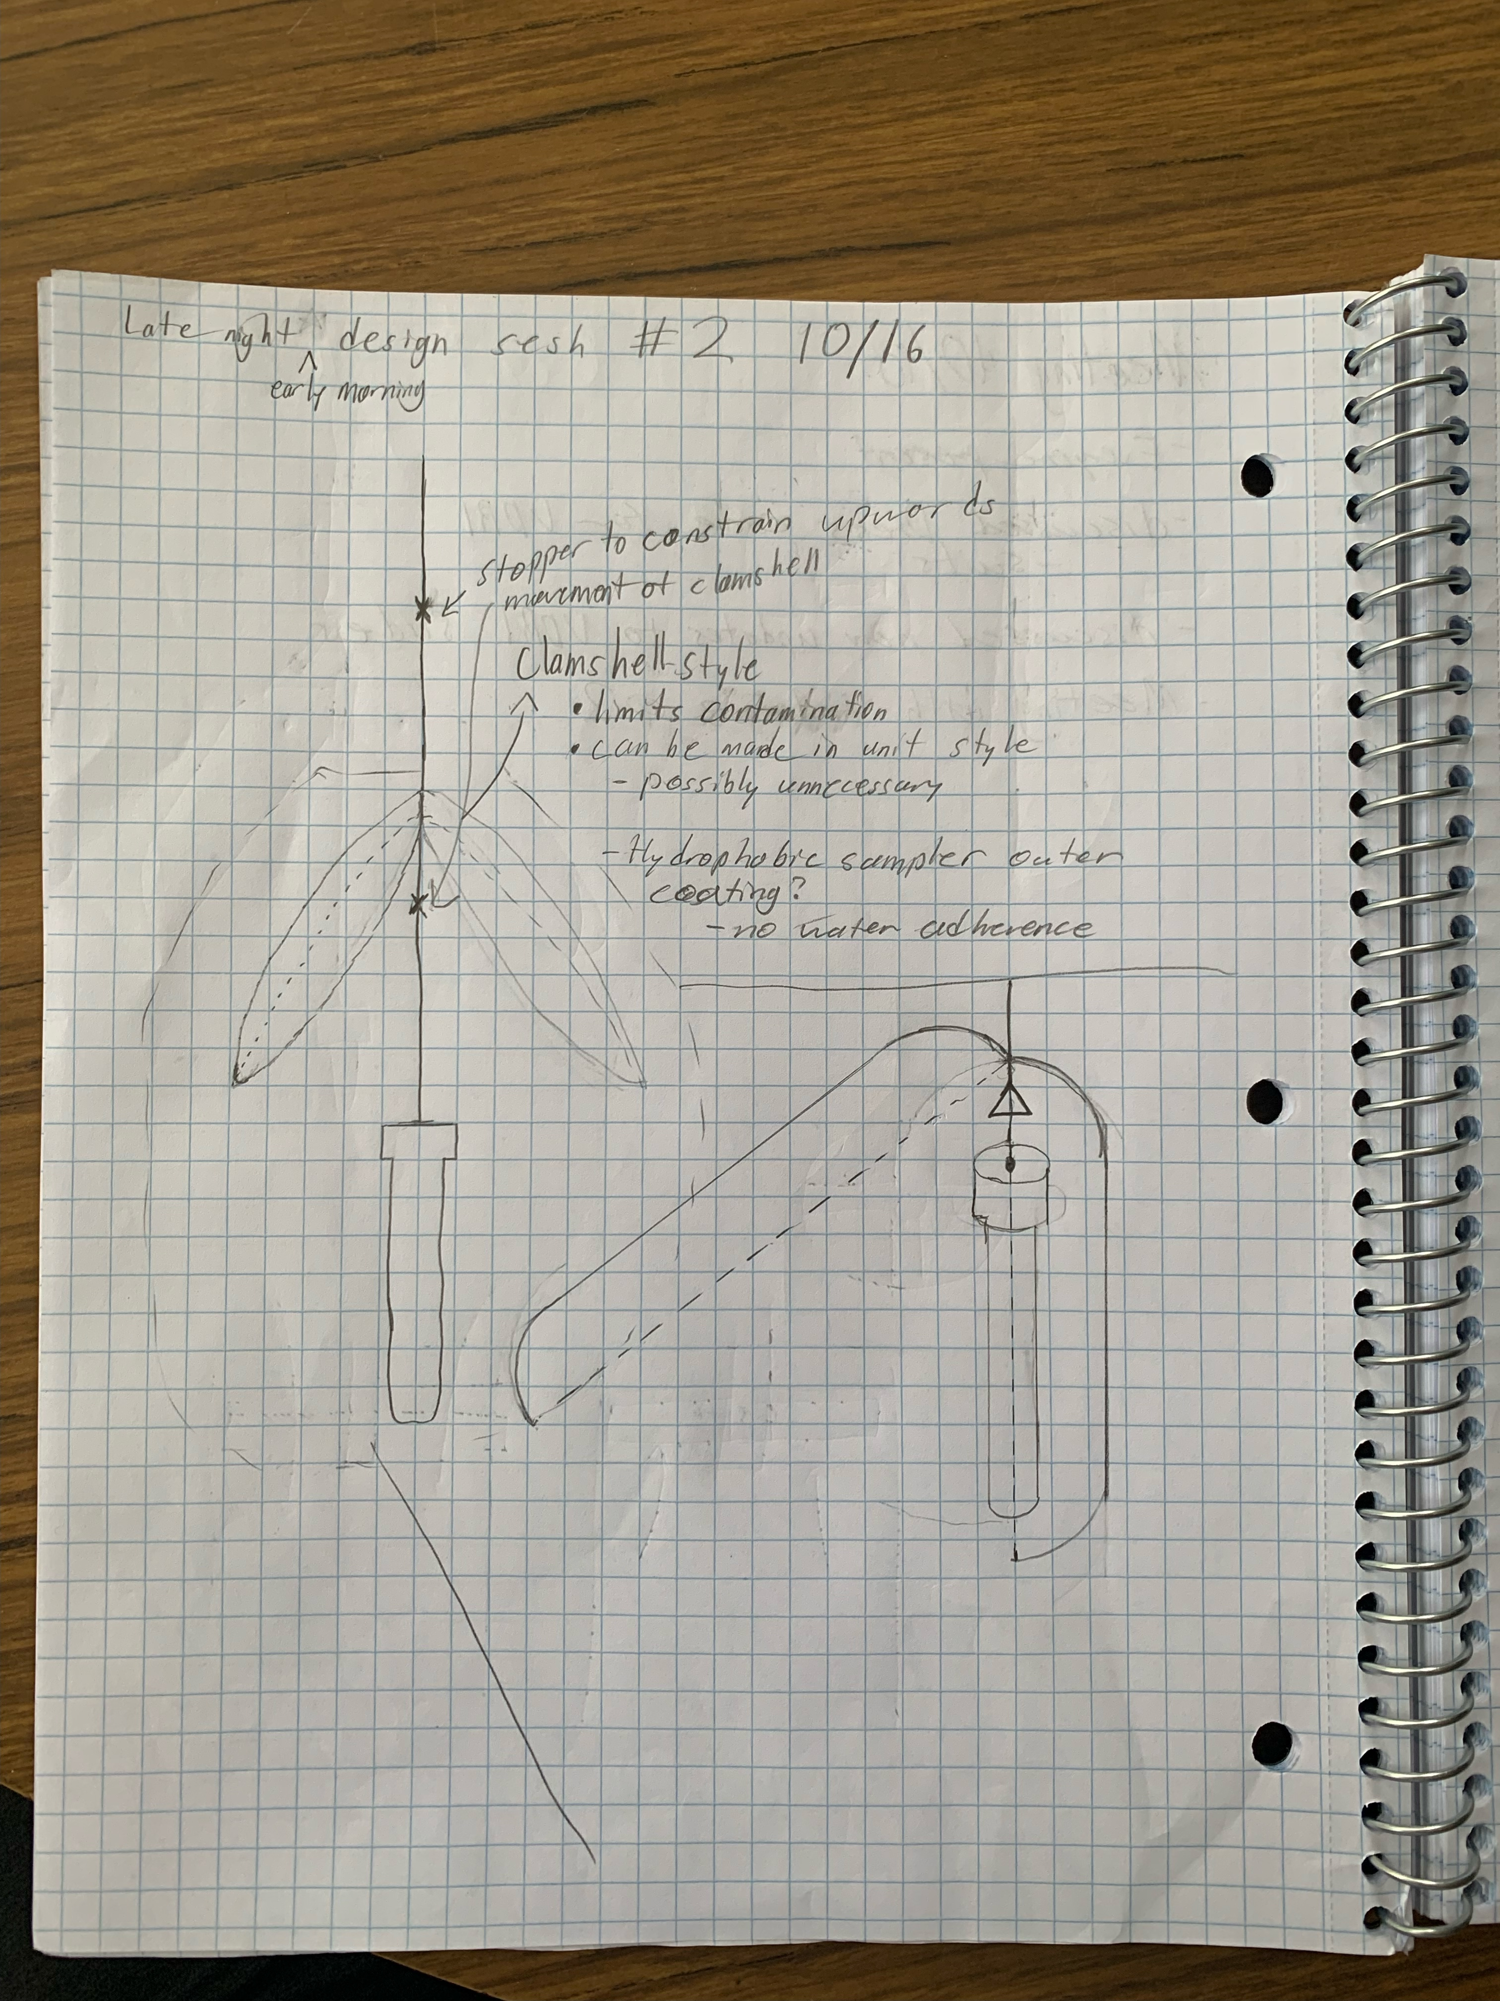
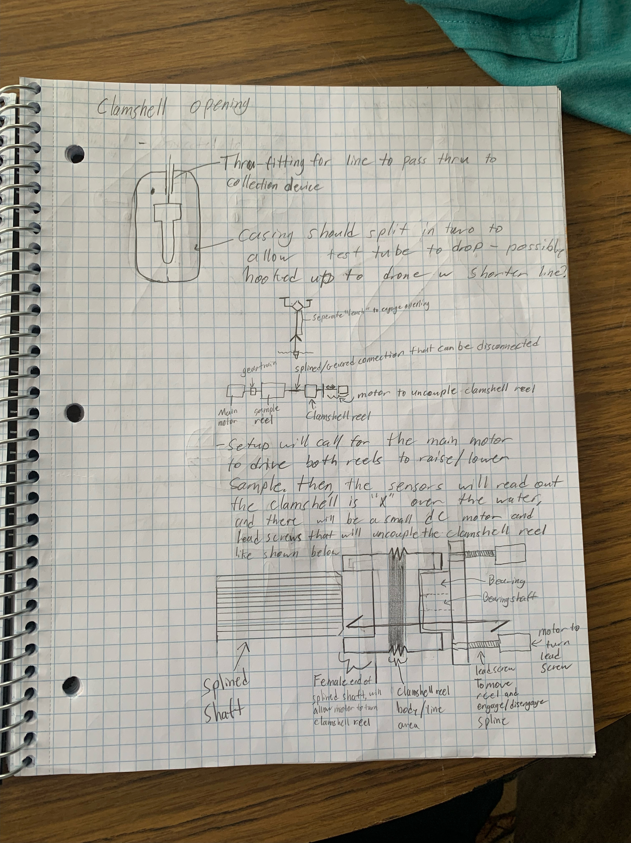
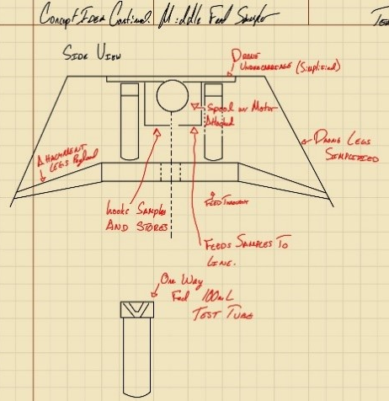
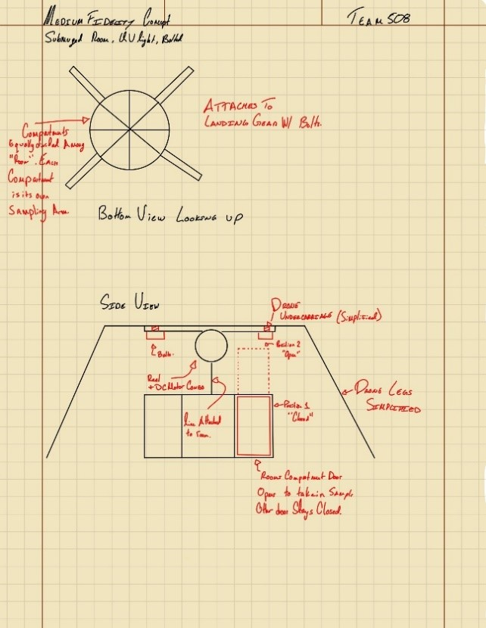
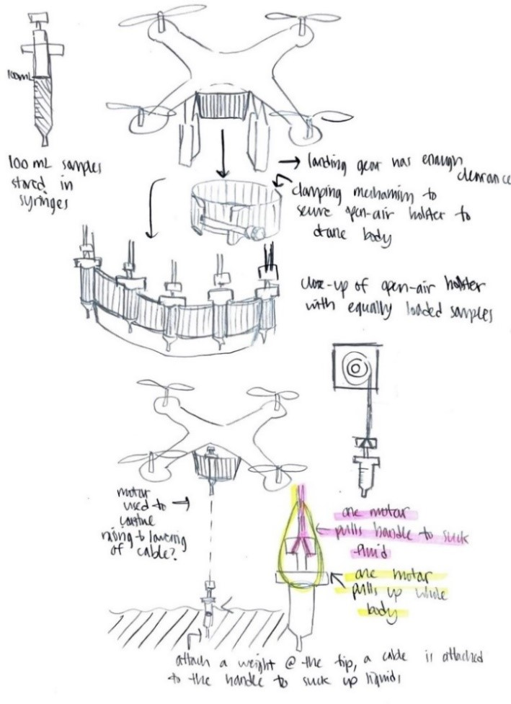
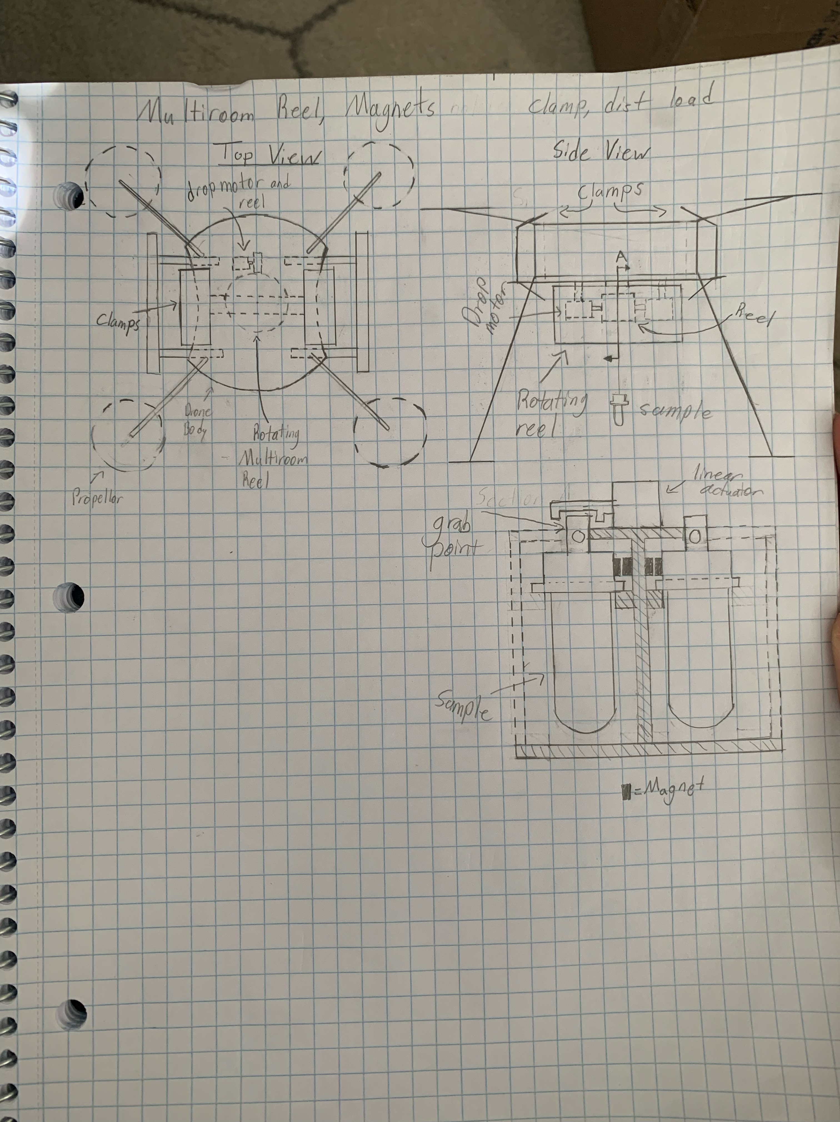
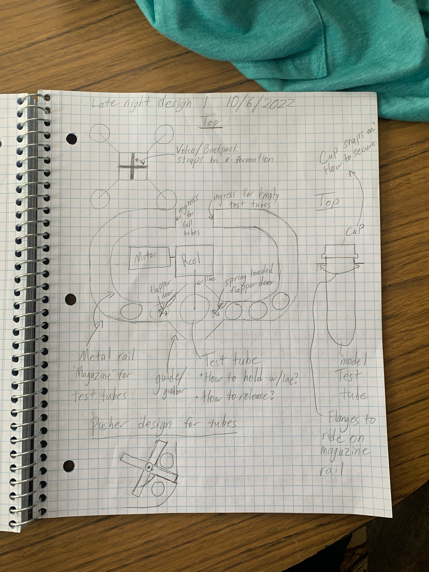
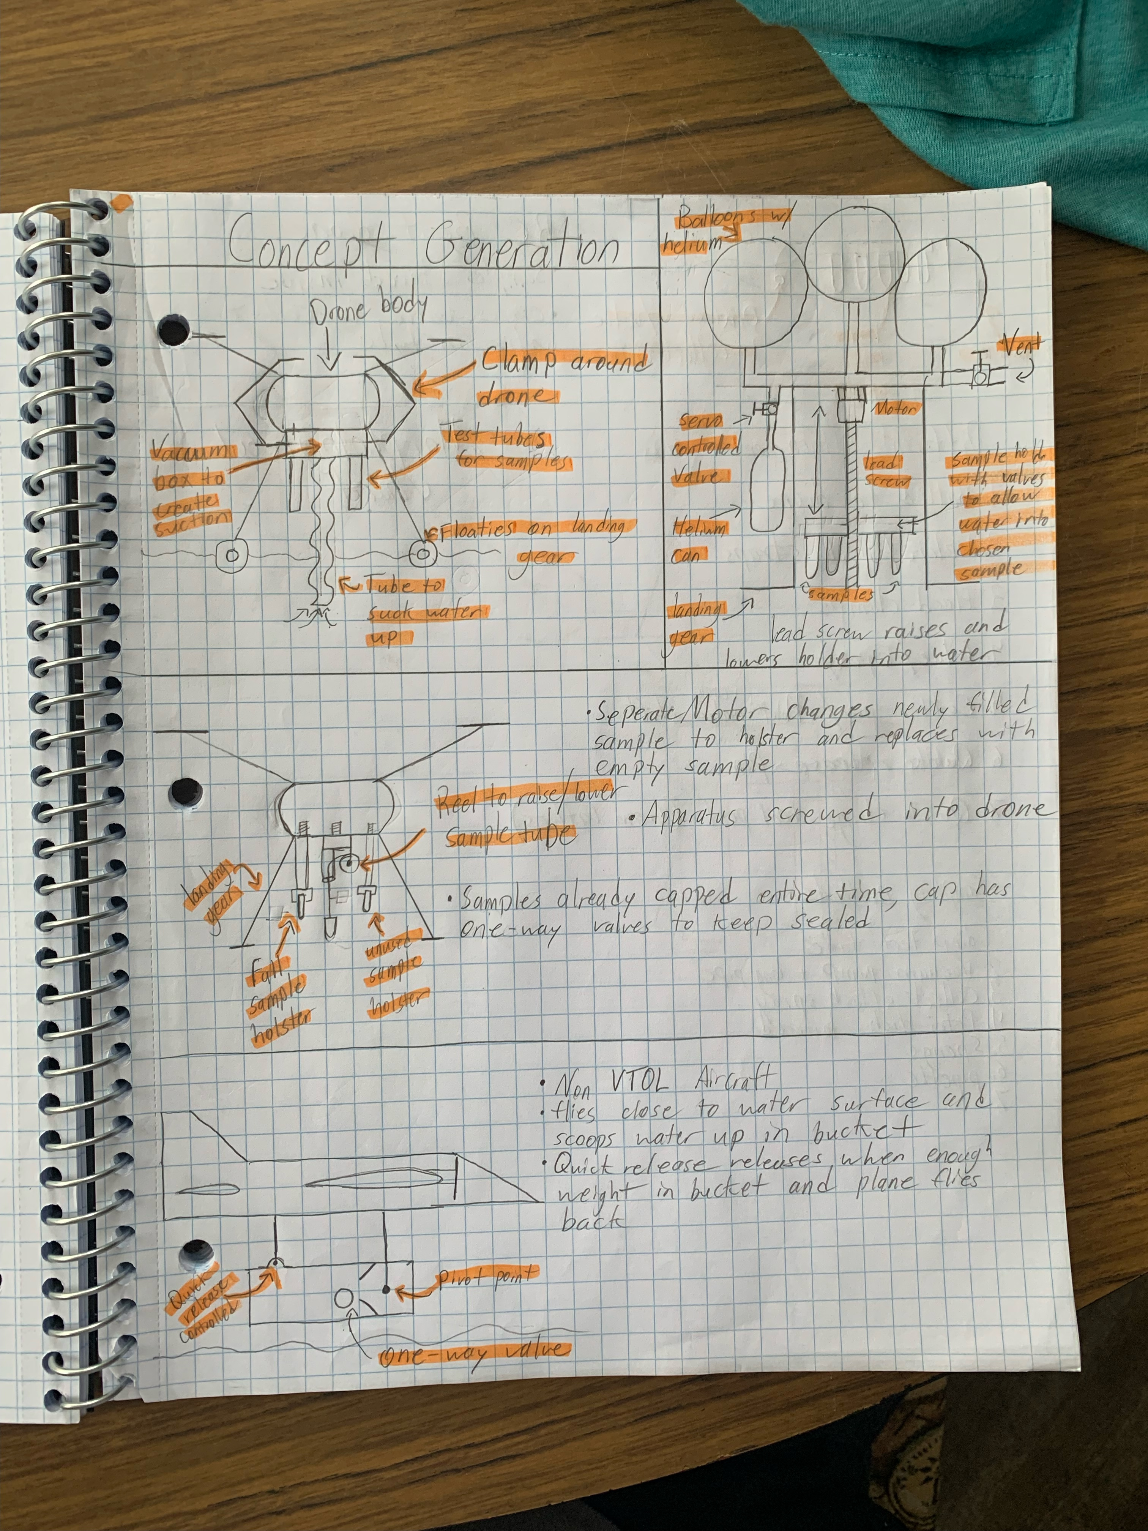
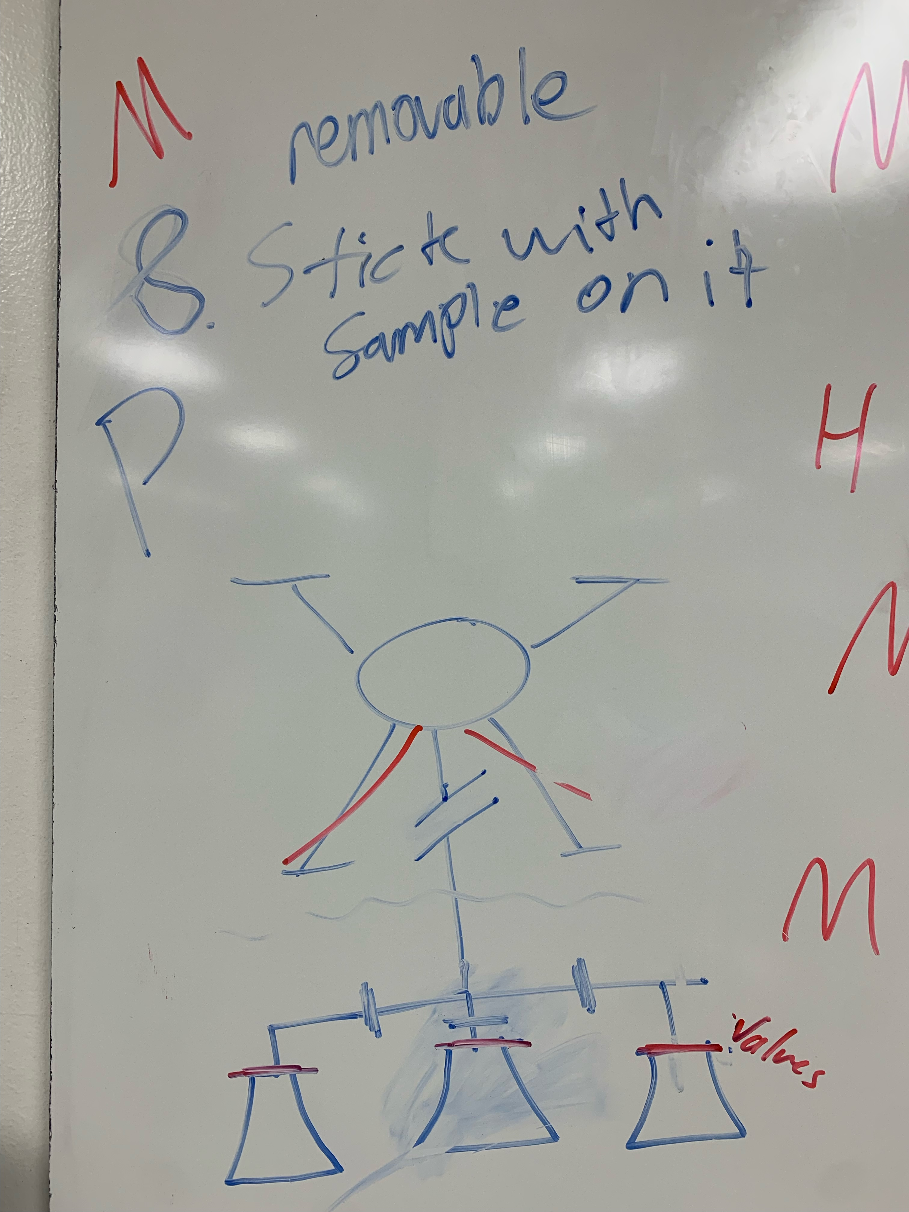
Matthew Lancaster
Notes:
Transition Slide: discuss how we went from targets and metrics to begin the process of concept generation

Slide 61
Critical Needs
and Characteristics
Tauben Brenner
Notes:
Talk about the 5 most important engineering characteristics. Mention 1) does not critically impede flight, 2) collect samples, 3) store samples, 4) multiple samples were the 4 critical customer requirements

Slide 62
Dominic Bellocchio
Notes:
So last time we spoke we showed this animation to

Slide 63









Concept Generation
Speaker
Notes:
We contacted a marine biologist with questions about collecting ocean samples for harmful substances to the environment.
We have received a response...
Tara specializes in testing for pathogens
Sample size requirements: 100 ml (100 g)
Sample collection requirements: keep it out of sunlight, UV light will harm validity of sample once it is taken (the natural conditions should be altered as little as possible when brought into the lab)
- surface collection is fine, since algae congregate at the surface level in dense portions.
Additional research resources: she told us to check out scholarly research articles related to our sample substances

Slide 64

Concept Selection
Binary Pairwise
Pugh Chart
House of Quality
Analytical Hierarchy
Roberto Lacasa
Notes:
BPwC: Ranked our 9 customer requirements in an order using rating for 0 or 1 to gauged importance vs eachother. This gave us relative weights to use in the HoQ
HoQ: MEasured how well each requirement related to the 11 engineering characteristics we generated . Used the imprtance weight factors of each customer requirement to determine a ranked order of which enigneering characteristics were most important to use in the Pugh Charts.
PC: in the first iteration, compared the medium and high fidelity concepts against a market option found online.

Slide 65


Slide 66



Slide 67
Functional Decomposition
Safety
Stability
Collection
Feedback
Roberto Lacasa
Notes:
Feedback – communication between the system and the user, it ties back into safety and stability.
The bottom line is that were are taking delicate and sensitive equipment into a chaotic and unpredictable environment, so mitigating disturbances is key.

Slide 68



Targets and Metrics
Function
Target
Metric
Carries Weight
Mass
3 kg
Weight Distribution
Max 100 g Offset
Maintains Center of Mass
Dylan Ma
Notes:
We contacted a marine biologist with questions about collecting ocean samples for harmful substances to the environment.
We have received a response...
Tara specializes in testing for pathogens
Sample size requirements: 100 ml (100 g)
Sample collection requirements: keep it out of sunlight, UV light will harm validity of sample once it is taken (the natural conditions should be altered as little as possible when brought into the lab)
- surface collection is fine, since algae congregate at the surface level in dense portions.
Additional research resources: she told us to check out scholarly research articles related to our sample substances

Slide 69

Assumptions
Built-in state estimation
The drone has a built-in flight controller
All testing will be done on shore
Drone has live video feedback
Dominic Bellocchio
Notes:
Since we are not designing for one specific drone, we need to make some assumptions on what type of drones will be able to handle our design. State estimation is a feedback system that gives information on the current state of the drone such as battery charge, detecting and identifying faults,

Slide 70

Markets
Primary
Dow Chemical and municipal and federal water monitoring agencies
Secondary
Agricultural organizations, disaster relief groups, and environmental conservation groups
Dominic Bellocchio

Slide 71



Customer Needs
Speaker
Notes:
We asked our project sponsors and advisor a list of questions that quantified what was needed for the design.
We interpreted their answers into need statements to keep us aligned with our goals as we moved forward with the project.

Slide 72
Targets and Metrics
Function
Target
Metric
Carries Weight
Mass
3 kg
Weight Distribution
Max 100 g Offset
Maintains Center of Mass
Dylan Ma
Notes:
We contacted a marine biologist with questions about collecting ocean samples for harmful substances to the environment.
We have received a response...
Tara specializes in testing for pathogens
Sample size requirements: 100 ml (100 g)
Sample collection requirements: keep it out of sunlight, UV light will harm validity of sample once it is taken (the natural conditions should be altered as little as possible when brought into the lab)
- surface collection is fine, since algae congregate at the surface level in dense portions.
Additional research resources: she told us to check out scholarly research articles related to our sample substances

Slide 73

Targets and Metrics
Function
Target
Metric
Attaches to Various Drones
Mounting Configurations
3 Attachments
Force
5N tension b/t payload and sample
Aborts Sampling Procedure
Dylan Ma
Notes:
We contacted a marine biologist with questions about collecting ocean samples for harmful substances to the environment.
We have received a response...
Tara specializes in testing for pathogens
Sample size requirements: 100 ml (100 g)
Sample collection requirements: keep it out of sunlight, UV light will harm validity of sample once it is taken (the natural conditions should be altered as little as possible when brought into the lab)
- surface collection is fine, since algae congregate at the surface level in dense portions.
Additional research resources: she told us to check out scholarly research articles related to our sample substances

Slide 74

Open/Close Valves
Dominic Bellocchio
Notes:
Beautiful animation to give a visual representation of the process and where the focus of our design is.

Slide 75

Project Background
Harmful algae blooms are on the rise
Dominic Bellocchio
Notes:
Why is this important? You have probably heard of red tide. Red tide is considered a harmful algal bloom, or HABs, these occur when colonies of algae grow out of control while producing toxic or harmful effects. Not all algae is bad. Algae is a major source of energy for the ocean food web.

Slide 76

Project Background
The benefit of using a drone.
Devastated ecosystems
Dominic Bellocchio
Dominic Bellocchio
Notes:
Ecosystems have been destroyed as a result of algae blooms.
The presence of algae diminishes the levels of oxygen in the water that the native marine life depend on for survival.
The algae produces toxins that kill fish and make shellfish dangerous to eat ultimately hurting local economies.
Dead zones – massive area of algae causes low oxygen which kills everything around it.

Slide 77

Project Background
The benefit of using a drone
Dominic Bellocchio
Notes:
Why use a drone? Drones are fast, you can take many samples over a large area, you can't use a boat because the boat will carry the algae on the hull,

Slide 78

Project Background
Sampling is needed
Dominic Bellocchio

Slide 79

Additional uses
Project Background
Dominic Bellocchio
Dominic Bellocchio
Notes:
Dow Chemical has interest in this design because they can use it for chemical testing at their manufacturing facilities.

Slide 80




Project Scope
Objective
Goals
Assumptions
Markets
Dominic Bellocchio
Notes:
Probably won't use.

Slide 81




Key Goals
Prevent Contamination
Collect Samples
The objective of the project …
Universal attachment
One kilogram payload
Dominic Bellocchio

Slide 82
Customer Needs
The payload can collect multiple samples without contamination
The drone only needs to transport the samples
The amount will allow for balancing
The payload should be 1 kg or less
The payload will be applicable to multiple drones
The payload can collect saltwater samples and chemicals
Payload is inert and retractable
The payload needs to be stable and unobtrusive

Slide 83



Customer Needs
What is the main objective of this project?
Would you like the samples to be tested during flight?
How many samples should the drone collect in one flight?
Questions
Dr. Ordonez: To collect multiple water samples remotely and safely without contamination.
Dr. Ordonez: No.
Dow: No.
Dr. Ordonez: At least 3. The drone payload should be able to distribute the samples equally while flying
Customer statements
The payload can collect multiple samples without contamination.
The payload can collect and store samples which will be transported by the drone.
The payload can balance multiple samples without affecting the drone’s ability to fly.
Interpreted needs

Slide 84
Customer Needs
What size samples would you need?
Would the payload need to be universally applicable?
What different fluids would you like to be collected?
Questions
Dr. Ordonez: That is a question for Marine Biologist, but you should consider a large payload of 1kg.
Dr. Ordonez: Yes
Dr. Ordonez: The primary concern is collecting samples of seawater to check for algae blooms.
Dow: The payload should collect several kinds of chemicals used in our manufacturing processes.
Customer statements
The payload is made of light-weight material and weighs less than 1 kg, including the samples.
The payload can be applied to drone bodies of all shapes and sizes.
The payload can collect ocean samples with algae blooms and samples from different chemicals without damage.
Interpreted needs

Slide 85
Customer Needs
How can the drone ensure safe use?
What are difficulties flying drones with payloads?
Questions
Dr. Ordonez: Be wary of the payload snagging and suspended wires.
Dow: No sparks and combusting materials
Dr. Ordonez: Stability is the number one concern.
Customer statements
Payload is inert and retractable
The payload does not interfere with flight
Interpreted needs

Slide 86

Functional Decomposition

Slide 87

Functional Decomposition

Slide 88
Functional Decomposition

Slide 89
Functional Decomposition

Slide 90
Functional Decomposition

Slide 91

Color Palette

